Slide 1
psychotherapy effectiveness & possible responses
Dr James Hawkins
www.goodmedicine.org.uk

Slide 2

exploring a couple of areas
a blast through the current rather shocking state of psychotherapy
brief discussion of four possible overlapping responses I’m exploring

Slide 3
my background
personal fascination with what is involved in leading a really full, worthwhile, “good” life – read philosophy at cambridge
1970 changed to medicine, took up yoga & meditation and (in ‘72) began exploring humanistic psychology & groupwork
late ‘70/early ‘80’s developed complimentary medical skills – chinese acupuncture, hypnosis, osteopathy, healing
became increasingly evidence-based and focused broadly on pain & stress – trained in cognitive-behavioural therapy, psychosexual medicine, and emotions-focused therapy
worked through own charity, shifted to working with stress & using the newly emerging evidence on wellbeing
now one-to-one work, run groups (life skills & opening up), teach, supervise & write a blog (www.goodmedicine.org.uk)
Notes:
Carlson et al - 3573
29 studies involving 1206 patients reviewed. results were encouraging and tended to increase between end of treatment and follow-up assessments about 3 months later. more sessions (about 12 sessions over 12 weeks) and the use of tapes are beneficial. individual a bit better than group if similar time. psychological and physical symptoms respond approximately equally well.

Slide 4
reasons to be pleased
100’s of psychotherapy meta-analyses show effect sizes of approximately 0.6 (0.4 to 0.8)
in the social sciences, this is a ‘medium’ to ‘strong’ effect size (for Cohen’s d)
it makes psychotherapy as or more potent than many well established EBM procedures including (for example) almost all intervent-ions in asthma, geriatrics, and cardiology
Lambert, M. J. (2013). “The efficacy and effectiveness of psychotherapy”
in M. J. Lambert (ed) “Handbook of psychotherapy and behavior change (6th ed)”

Slide 5
reasons to be pleased
reductions in relapse rates compared to medication or no treatment – so for depression a meta-analysis by De Maat et al (2006) reported a relapse rate of 27% for psychotherapy but a rate of 57% for pharmacotherapy (if medication was discontinued)
there is also a growing research literature (Smith & Williams, 2013) highlighting reductions in medical & psychological treatment costs and reductions in time off work achievable with psychological interventions
De Maat, S., et al. (2006). "Relative efficacy of psychotherapy and pharmacotherapy in the treatment of depression: A meta-analysis." Psychotherapy Research 16(5): 566-578
Smith, T. W. & P. Williams (2013). “Behavioral medicine and clinical health psychology.” in M. J. Lambert (ed) “Handbook of psychotherapy and behavior change (6th ed)”

Slide 6
reasons to be pleased disappointed
100’s of psychotherapy meta-analyses show effect sizes of approximately 0.6 (0.4 to 0.8)
but since Smith, Glass & Miller’s estimate of an 0.85 effect size from a meta-analysis of 475 studies in 1980, there has been no general effectiveness increase over the next 35 years
in fact improved statistical methods suggest we have been over-estimating effectiveness
Lambert, M. J. (2013). “The efficacy and effectiveness of psychotherapy”
in M. J. Lambert (ed) “Handbook of psychotherapy and behavior change (6th ed)”

Slide 7

concerns about how well we help those struggling with depression
dodo bird: no large differences in efficacy between seven different approaches (Cuijpers et al, 2008)
research quality for third wave therapies such as ACT, DBT, etc somewhat poor (Ost, 2014)
publication bias seems to have considerably over-estimated effect sizes (Cuijpers et al, 2010)
Cuijpers, P., et al. (2008). "Psychotherapy for depression in adults: A meta-analysis of comparative outcome studies." J Consult Clin Psychol 76(6): 909-922.
Öst, L.-G. (2014). "The efficacy of Acceptance and Commitment Therapy: An updated systematic review and meta-analysis." Behav Res and Therapy 61(10): 105-121. Cuijpers, P., et al. (2010). "Efficacy of CBT & other psychological treatments for adult depression: Meta-analytic study of publication bias." Br J Psychiatry 196: 173-178.

Slide 8
... & those struggling with anxiety
“Psychological therapies, in general, have been found to be highly effective for anxiety-based problems. The family of cognitive and behavior therapies have been studied most often and extensively … “ (Lambert, 2013)
“Cognitive-behavior therapies (CBT) have been evaluated in randomized controlled studies (RCT) and anxiety disorders since 1966 … (No meta-analysis) … has looked at whether modern CBT studies lead to better treat-ment effects than were obtained 10-40 years ago. The aim of this paper is to present a meta-analysis focusing on the mean extent of change achieved by the CBT treatments across decades (from the 1970s onwards) … The results showed that in most instances there was no significant change in ES (effect size) across time … If the single studies that gave the highest ES each decade were compared, all anxiety disorders besides panic disorder and obsessive-compulsive disorder showed a positive development.” (Ost, 2008)
Lambert, M. J. (2013). “The efficacy and effectiveness of psychotherapy”
in M. J. Lambert (ed) “Handbook of psychotherapy and behavior change (6th ed)”
Ost, L. G. (2008). "Cognitive behavior therapy for anxiety disorders: 40 years of progress." Nord J Psychiatry 62 Suppl 47: 5-10.

Slide 9
& more concerns with depression
effect sizes achieved by CBT treatment for depression over the last 40 years
have effect sizes changed over the years?
if so, what are the causes?
  study quality? depression severity? comorbidity? use of manual? therapist training/experience?
Johnsen, T. J. and O. Friborg (2015). "The effects of cognitive behavioral therapy as an anti-depressive treatment is falling: a meta-analysis." Psychol Bull. 141(4): 747-768
https://uit.no/Content/418448/The%20effect%20of%20CBT%20is%20falling.pdf

Slide 10
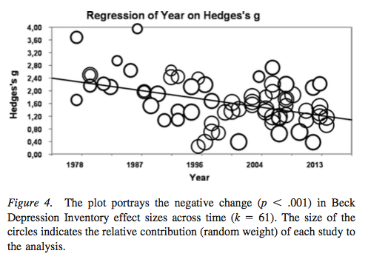
& more concerns with depression

Slide 11
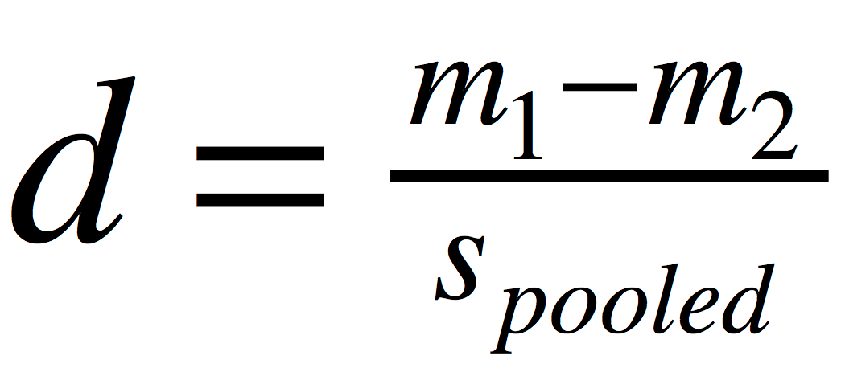
what is Cohen’s d?
Cohen’s d is calculated from the difference between the means of the two populations being compared, divided by their pooled standard deviation (a measure of how spread out numbers are)
Cohen, J. (1988) “Statistical power analysis for the behavioral sciences (2nd ed)”
Mahwah, NJ: Lawrence Erlbaum Associates

Slide 12
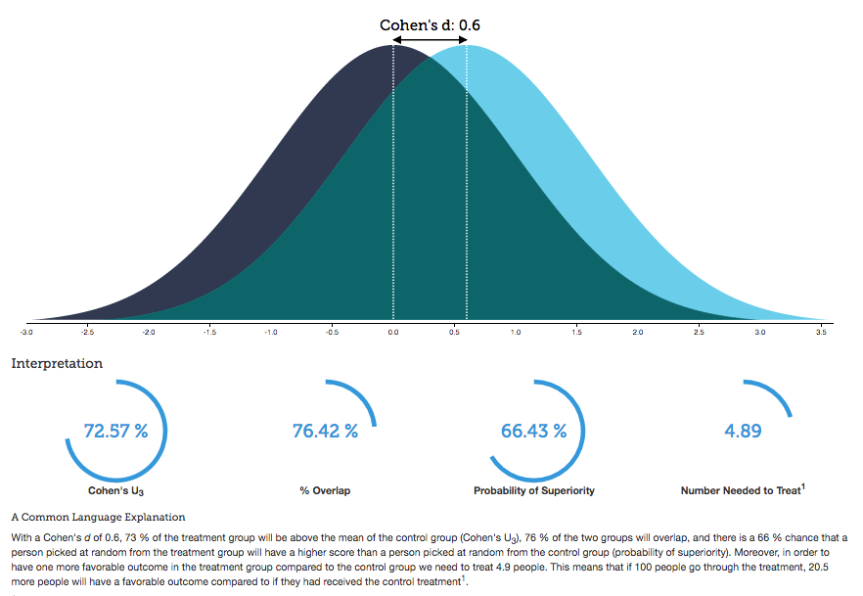
interpreting Cohen’s d effect size
Kristoffer Magnusson “Interactive visualisation of Cohen’s d effect size”
http://rpsychologist.com/d3/cohend/

Slide 13
effect sizes with interpretations
effect size: cohen’s d | % of untreated controls below mean of treated | % of variability in outcome due to treatment | % success in those not treated | % success in those treated
0.0 | 50 | 0 | 50 | 50
medium
0.3 | 61.8 | 2.2 | 42.6 | 57.4
0.5 | 69.1 | 5.9 | 37.9 | 62.1
0.6 | 72.6 | 8.3 | 35.6 | 64.4
0.7 | 75.8 | 10.9 | 33.5 | 66.5
large
0.8 | 78.8 | 13.8 | 31.4 | 68.6
0.9 | 81.6 | 16.8 | 29.5 | 70.5
1.0 | 84.1 | 20 | 27.6 | 72.4
Lambert, M. J. (2013) “The effectiveness of psychotherapy”
in M. J. Lambert (ed) “Handbook of psychotherapy and behavior change (6th ed)”
Wampold, B. E. (2001) “The great psychotherapy debate: models, methods & findings”

Slide 14
effect sizes of therapeutic factors
collaboration
many more research studies in these 2 areas
therapists
naturalistic
alliance
empathy
affirmation
congruence
therapists
rct’s
effect size
treatment differences
competence
ingredients
specific factors
contextual factors
Wampold, B. & Z. Imel (2015). ”The great psychotherapy debate: the evidence for what makes psychotherapy work (2nd ed)." p.258 (adapted). Routledge: New York.

Slide 15
a contextual model
therapist
real relationship
belongingness, social connection
better life quality
trust
understanding
expertise
creation of expectation through explanation & some form of treatment
symptom
reduction
tasks
goals
therapeutic
actions
healthy
actions
client
Wampold, B. & Z. Imel (2015). ”The great psychotherapy debate: the evidence for what makes psychotherapy work (2nd ed)." p.54 (adapted). Routledge: New York.

Slide 16
exploring a couple of areas
a blast through the current rather shocking state of psychotherapy
brief discussion of four possible overlapping responses I’m exploring

Slide 17

four suggestions for ways out of our impasse
identification and study of highly successful therapists’ methods and characteristics
routine outcome monitoring to encourage alerts and problem-solving if one is going off track
teaching & specific training in ‘facilitative interpersonal skills’
lessons from emerging research on how people develop excellence

Slide 18

a focus only on therapy differences misses other crucial sources of help
Mulla Nasrudin
and the lost keys

Slide 19
increasingly research shows major differences between therapists
Brown, G. S. and E. R. Jones (2005). "Implementation of a feedback system in a managed care environment: What are patients teaching us?" Journal of Clinical Psychology 61(2): 187-198.
Okiishi, J. C., M. J. Lambert, et al. (2006). "An analysis of therapist treatment effects: Toward providing feedback to individual therapists on their clients' psychotherapy outcome." Journal of Clinical Psychology 62(9): 1157-1172
Lutz, W., S. C. Leon, et al. (2007). "Therapist effects in outpatient psychotherapy: A three-level growth curve approach." Journal of Counseling Psychology 54: 32-39.
Anderson, T., B. M. Ogles, et al. (2009). "Therapist effects: Facilitative interpersonal skills as a predictor of therapist success." J Clinical Psychology 65: 755-768.
Kraus, D. R., L. Castonguay, et al. (2011). "Therapist effectiveness: Implications for accountability and patient care." Psychotherapy Research 21(3): 267-276.
Saxon, D. and M. Barkham (2012). "Patterns of therapist variability: Therapist effects & the contribution of patient severity and risk." J Consult Clin Psychol 80(4): 535-546.
Baldwin, S. A. & Imel, Z. E. (2013). “Therapist effects: Findings and methods” in M. J. Lambert (ed) “Handbook of psychotherapy and behavior change (6th ed)”

Slide 20
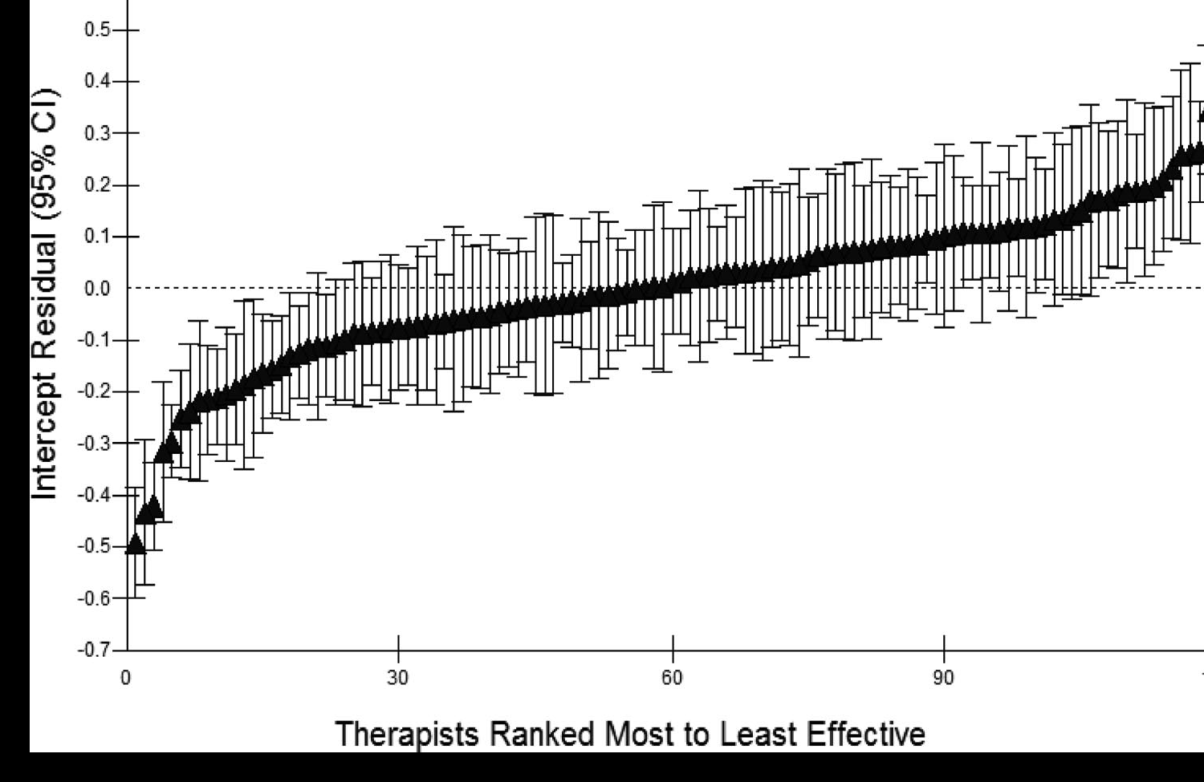
therapist effects
Saxon, D. & M. Barkham (2012). "Patterns of therapist variability: Therapist effects & the contribution of patient severity and risk." J Consult Clin Psychol 80(4): 535-546.

Slide 21
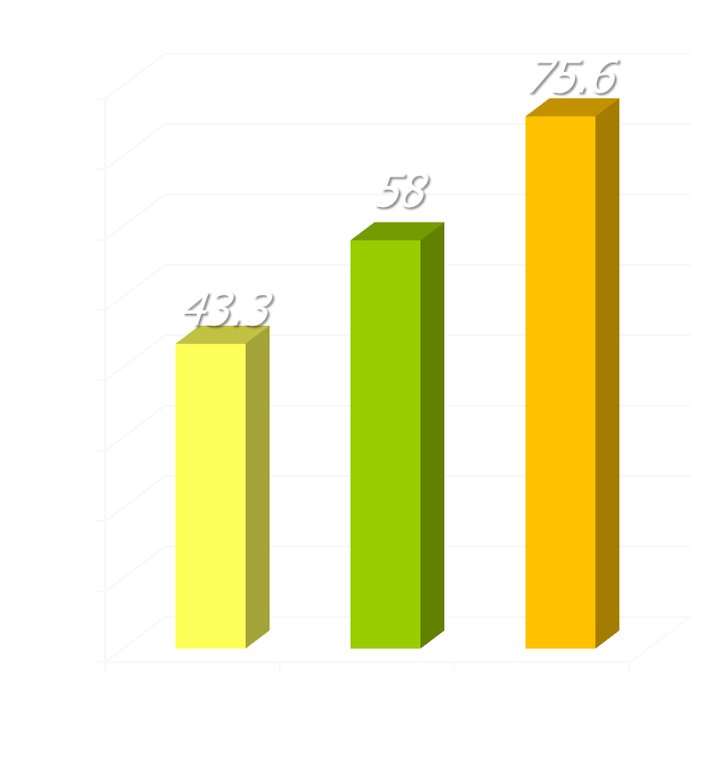
differences in recovery rates
research in UK NHS adult primary care counseling & psychological therapy services
recovery rates
study of 119 therapists treating 10,786 patients
recovery used the standard Jacobson & Truax criteria: reliable change to below the clinical cut-off
three groups of therapists found, comprising 19 poor (16%), 79 average (66%), and 21 excellent (18%)
Saxon, D. & M. Barkham (2012). "Patterns of therapist variability: Therapist effects & the contribution of patient severity and risk." J Consult Clin Psychol 80(4): 535-546.

Slide 22

why therapist effects differences?
research suggests that differences in therapist effectiveness are NOT due to:
type of therapy being used
therapist qualifications/training
duration of therapist experience
therapist age
therapist gender
Baldwin, S. A. and Z. E. Imel (2013). “Therapist effects: findings and methods”
in M. J. Lambert (ed) “Handbook of psychotherapy and behavior change (6th ed)”

Slide 23
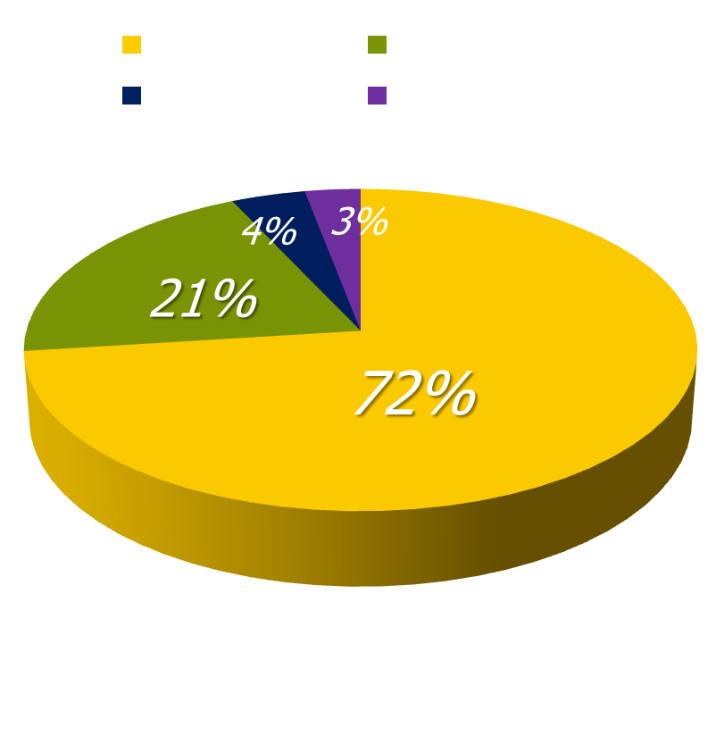
effects of increasing experience
systematic review of 62 studies published between 1966 and 2004 looking at physician experience effects
73% found increasing experience associated with decreasing performance for some (21%) or all (52%) outcomes assessed
there seems to be an inverse relationship between years of experience and the quality of care that is provided
Choudhry, N. K., et al. (2005). "Systematic review: The relationship between clinical experience and quality of health care." Ann Intern Med 142(4): 260-273.

Slide 24
effects of increasing experience
Researchers examined the association between experience and mortality rates for surgeons performing cardiac artery bypass grafting. After adjust-ment for both patient and doctor variables, they found that surgeons who had been in practice longer had higher operative mortality rates (P<0.001).
Hartz A. J., et al. (1999). “Prestige of training programs and experience of bypass surgeons as factors in adjusted patient mortality rates.” Med Care. 37:93-103.
Mortality rates were analyzed for 39,007 hospitalized patients with acute myo-cardial infarction managed by 4,546 cardiologists, internists & family pract-itioners. After controlling for patient’s probability of death, hospital location & practice environment, physician specialty, board certification & the volume of patients seen, the researchers found a 0.5% increase in mortality for every year since the treating physician had graduated from medical school.
Norcini, J. J., et al. (2000). "Certification and specialization: Do they matter in the outcome of acute myocardial infarction?" Academic Medicine 75(12): 1193-1198.

Slide 25
effects of increasing experience not so relevant for psychotherapy
Goldberg, S. B., et al. (2016). "Do psychotherapists improve with time and experience? A longitudinal analysis of outcomes." J Couns Psychol 63: 1-11.
“Therapists (170) achieved outcomes comparable with benchmarks from clinical trials. However, a very small but statistically significant change in outcome was detected indicating that on the whole, therapists' patient prepost d tended to diminish as experience (time mean<5yr or cases) increases … Further, therapists were shown to vary significantly across time, with some therapists showing improvement despite the overall tendency for outcomes to decline.”
Hill , C. E. and S. Knox (2013). “Training and supervision in psychotherapy”
in M. J. Lambert (ed) “Handbook of psychotherapy & behavior change 6th ed”
“Two recent analyses of very large numbers of therapists (652) perhaps provide the most definitive evidence about therapist experience … In summary ... more recent studies involving large numbers of therapists showing no effects.”

Slide 26
effects of increasing experience not so relevant for psychotherapy
Wampold, B. E. and G. S. Brown (2005). "Estimating variability in outcomes attributable to therapists: a naturalistic study of outcomes in managed care." J Consult Clin Psychol 73(5): 914-923.
“the authors analyzed the outcomes of 6,146 patients seen by approximately 581 therapists in the context of managed care … therapist age, gender, experience, and professional degree accounted for little of the variability in outcomes.”
Okiishi, J. C., M. J. Lambert, et al. (2006). "An analysis of therapist treatment effects: Toward providing feedback to individual therapists on their clients' psychotherapy outcome." Journal of Clinical Psychology 62(9): 1157-1172
“data collected on over 5,000 clients seen by 71 therapists over a 6-year period … client recovery could not be shown to be a function of differences in therapist gender, professional training, professional experience, or theoretical orientation.”

Slide 27
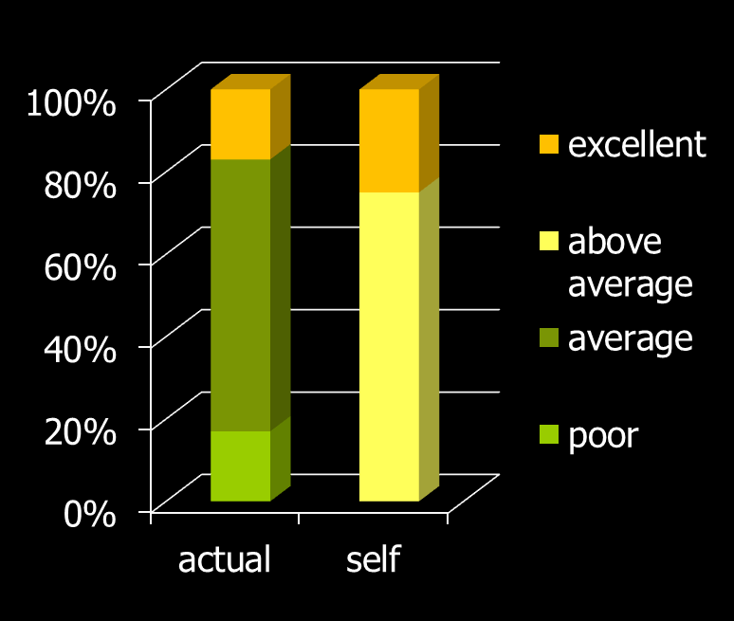
self-assessment isn’t accurate
multidisciplinary sample of mental health professionals
compare their own overall clinical skills & performance to others in their profession
25% assessed themselves to be in the top 10% of skills & performance & none viewed themselves as below average
assessment
Walfish, S., B. McAlister, et al. (2012). "An investigation of self-assessment
bias in mental health providers." Psychol Rep 110(2): 639-644.
Davis, D., et al. (2006). "Accuracy of physician self-assessment compared with observed measures of competence: A systematic review." JAMA 296: 1094-1102

Slide 28
therapist effects: tentative findings
the difference in outcome between better & worse therapists stands out most with more complex, challenging patients (Saxon & Barkham, 2012).
more effective therapists seem to be more resilient & mindful than less effective therapists (Pereira, 2015)
it seems that “facilitative interpersonal skills” demon-strated specifically in difficult interpersonal situations are of particular importance (Anderson, 2009/15/16)
more effective therapists’ better interpersonal skills also tend to become evident in general discussions & seem predictive of future results (Schottke, 2016)
sessional outcome/alliance monitoring seems helpful especially for less effective therapists (Anker, 2009)

Slide 29
four suggestions for ways out of our impasse
identification and study of highly successful therapists’ methods and characteristics
routine outcome monitoring to encourage alerts and problem-solving if one is going off track
teaching & specific training in ‘facilitative interpersonal skills’
lessons from emerging research on how people develop excellence

Slide 30
practice-based evidence
“At its heart, practice-based evidence is premised on the adoption and ownership of a bona fide measurement system and its implementation as standard procedure within routine practice.”
celesthealth system for mental health & college counseling settings (chs-mh) www.celesthealth.com
clinical outcomes in routine evaluation (core) www.coreims.co.uk
outcome questionnaire-45 (oq45) & linked measures www.oqmeasures.com
partners for change outcome management system (pcoms) http://scottdmiller.com & https://heartandsoulofchange.com
treatment outcome package (top) www.outcomereferrals.com
Castonguay, L., M. Barkham, W. Lutz, et al. (2013). “Practice-orientated research.” in M. J. Lambert (ed) “Handbook of psychotherapy and behavior change (6th ed)”

Slide 31
helping improve outcomes … especially when non-response risk
“ … repeated assessment and immediate feed-back of a patient’s mental health functioning during the course of therapy can alert therapists to patient non-response or negative response, support decisions on treatment planning and strategies (e.g. when and how to repair thera-peutic alliance ruptures) and help determine when treatment has been sufficient.”
Castonguay, L., M. Barkham, W. Lutz, et al. (2013). “Practice-orientated research.” in M. J. Lambert (ed) “Handbook of psychotherapy and behavior change (6th ed)”

Slide 32
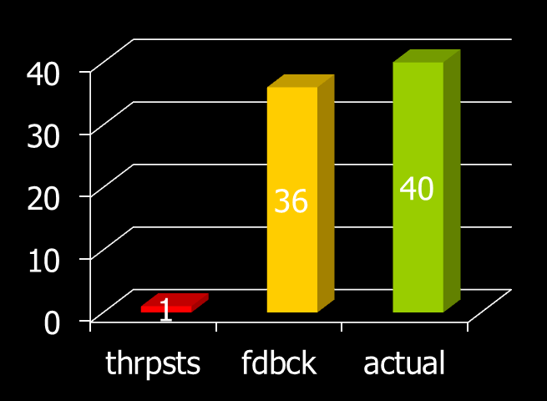
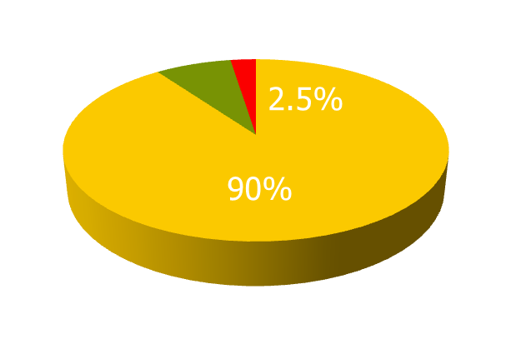
bad at identifying deterioration
550 clients & 48 therapists (22 licensed, 26 trainees)
told that 8% of clients would probably deteriorate & they were asked to identify them
40/550 (7.3%) of clients actually deteriorated (OQ-45)
actuarial feedback identified 36/40 – a 90% detection rate
therapists identified 3, only 1 of whom actually deteriorated – a 2.5% detection rate
it was a trainee who was the only one who was accurate
Hannan, C., M. J. Lambert, et al. (2005). "A lab test and algorithms for identifying clients at risk for treatment failure." Journal of Clinical Psychology 61(2): 155-163.

Slide 33
using regular sessional feedback helps therapists improve outcomes
M. Barkham, G. E. Hardy & J. Mellor-Clark (ed’s) (2010) “Developing and delivering practice-based evidence.” Chichester: John Wiley & Sons.
Newnham, E. A. and A. C. Page (2010). "Bridging the gap between best evidence and best practice in mental health." Clin Psychol Rev 30(1): 127-142.
Shimokawa, K., M. J. Lambert, et al. (2010). "Enhancing treatment outcome of patients at risk of treatment failure: Meta-analytic and mega-analytic review of a psychotherapy quality assurance system." J Consult Clin Psychol 78(3): 298-311.
Lambert, M. J. (2010) "Prevention of treatment failure: the use of measuring, monitoring, and feedback in clinical practice". Washington: Am Psych Association
Lutz, W., J. R. Bohnke, et al. (2011). "Lending an ear to feedback systems: Evaluation of recovery and non-response in psychotherapy in a German outpatient setting." Community Ment Health J 47(3): 311-317.
Whipple, J. L. and M. J. Lambert (2011). "Outcome measures for practice." Annual review of clinical psychology 7: 87-111.
Carlier, I. V., D. Meuldijk, et al. (2012). "Routine outcome monitoring & feedback on physical or mental health status: Evidence and theory." J Eval Clin Pract 18: 104-110.

Slide 34
to get best results from feedback
best results typically depend on the therapists involved being committed to using feedback
regular sessional assessment of outcome progress & therapeutic alliance given to both therapist & client for possible discussion
current evidence suggests this halves client deterioration rates
there are encouraging increases in treatment gains as well - e.g. using pcoms, reliable improve-ment rates increase by 3.5 x
Castonguay, L., M. Barkham, W. Lutz, et al. (2013). “Practice-orientated research.” in M. J. Lambert (ed) “Handbook of psychotherapy and behavior change (6th ed)”

Slide 35
although caution & further evolution of the ideas is needed
Kendrick, T., et al. (2016). "Routine use of patient reported outcome measures (PROMs) for improving treatment of common mental health disorders in adults." Cochrane Database of Systematic Reviews 7: 1-106.
Davidson, K., et al. (2015). "Would continuous feedback of patient's clinical outcomes to practitioners improve NHS psychological therapy services?" Psychology and Psychotherapy: Theory, Research and Practice 88(1): 21-37.
Guo, T., et al. (2015). "Measurement-Based Care Versus Standard Care for Major Depression: A Randomized Controlled Trial." Am J Psychiatry 172(10): 1004-1013.
Connolly Gibbons, M. B., et al. (2015). "The effectiveness of clinician feedback in the treatment of depression in the community mental health system." J Consult Clin Psychol 83(4): 748-759.
Slone, N. C., et al. (2015). "Evaluating the efficacy of client feedback in group psychotherapy." Group Dynamics: Theory, Research, and Practice 19(2): 122-136.
Lutz, W., et al. (2015). "Feedback and therapist effects in the context of treatment outcome and treatment length." Psychother Res 25(6): 647-660.
Boswell, J. F., et al. (2015). "Implementing routine outcome monitoring in clinical practice: Benefits, challenges, & solutions." Psychotherapy Research 25(1): 6-19.

Slide 36
four suggestions for ways out of our impasse
identification and study of highly successful therapists’ methods and characteristics
routine outcome monitoring to encourage alerts and problem-solving if one is going off track
teaching & specific training in ‘facilitative interpersonal skills’
lessons from emerging research on how people develop excellence

Slide 37

facilitative interpersonal skills (fis)
there is evidence that differences between poor, good & excellent therapists become more obvious when working with more complex, challenging clients
when assessing expertise in other disciplines … for example airline pilots ... assessments often involve videoing pilot responses to simulated plane crises
assessing therapist responses to simulated ‘crises’ with challenging clients therefore has considerable face validity
there are intriguing implications for the use of recorded, assessed, problem-solved & then repeated interactions with acted out therapist-client challenges

Slide 38

facilitative interpersonal skills
This study examined sources of therapist effects in a sample of 25 therapists who saw 1,141 clients at a university counsel-ing center … Therapists' facilitative inter-personal skills (FIS) were assessed with a performance task that measures therapists' interpersonal skills by rating therapist responses to video simulations of challenging client–therapist interactions … only FIS accounted for variance in out-comes suggesting that a portion of the variance in outcome between therapists is due to their ability to handle interperson-ally challenging encounters with clients.
Anderson, T., B. M. Ogles, et al. (2009). "Therapist effects: Facilitative inter-personal skills as a predictor of therapist success." J Clin Psychol 65: 755-68

Slide 39

fis assessment & scoring
7 brief (1-2 min) video clips of challenging situations
the clips cover a variety of difficult client interactions – both friendly/hostile and dominant/submissive
the therapist watches and then immediately records their response to what the client has been saying
this response is then scored on (currently) eight scales to give an overall FIS score

Slide 40

fis assessment & scoring
the eight criteria are:
verbal fluency
hope and positive expectations
persuasiveness
emotional expression
warmth, acceptance and understanding
empathy
alliance bond capacity
alliance rupture-repair responsiveness

Slide 41

facilitative interpersonal skills
Anderson, T., B. M. Ogles, et al. (2009). "Therapist effects: Facilitative interpersonal skills as a predictor of therapist success." J Clinical Psychology 65: 755-768
Anderson, T., et al. (2016). "A prospective study of therapist facilitative interpersonal skills as a predictor of treatment outcome." J Consult Clin Psychol 84(1): 57-66
Anderson, T., et al. (2016). "Therapist facilitative interpersonal skills and training status: A randomized clinical trial on alliance and outcome." Psychother Res 26(5): 511-29
Schöttke, H., et al. (2016). "Predicting psychotherapy outcome based on therapist interpersonal skills: A five-year longitudinal study of a therapist assessment protocol." Psychother Res. Published online 6 Jan

Slide 42
emerging fis-related research
Anderson, T., B. M. Ogles, et al. (2009). "Therapist effects: Facilitative inter-personal skills as a predictor of therapist success" J Clin Psychol 65: 755-68
”This study examined sources of therapist effects in a sample of 25 therapists who saw 1,141 clients at a university counseling … (from a wide variety of therapist characteristics – therapeutic orientation qualifications, etc) only FIS accounted for variance in outcomes”
Anderson, T., et al. (2016). "A prospective study of therapist facilitative interpersonal skills as a predictor of treatment outcome." JCCP 84: 57-66
“ … examined whether therapists’ (44 clin psychology PhD students) facilitative interpersonal skills (FIS) would prospectively predict the outcomes of therapies that occurred more than one year later (when they began work as trainees in the department’s training clinic) … therapist FIS significantly predicted client symptom change … higher FIS therapists were more effective than lower FIS therapists”

Slide 43
emerging fis-related research
Anderson, T., et al. (2016). "Therapist FIS and training status: A randomized clinical trial on alliance and outcome." Psychother Res 26(5): 511-529,
”tested the efficacy of therapists who were selected by their facilitative interpersonal skills (FIS) and training status (11 with at least 2 years of clinical psychology training & 12 from various other university subjects with no psychotherapy training) … Outcome and alliance differences for training status were negligible. High FIS therapists had greater pre–post client outcome, and higher rates of change across sessions, than low FIS therapists.”
Schöttke, H., et al. (2016). "Predicting psychotherapy outcome based on therapist interpersonal skills: A five-year longitudinal study of a therapist assessment protocol." Psychother Res. Published online 6th Jan
“ … trainees' with more positively rated interpersonal behaviors assessed in the observer-rated group format … showed superior outcomes over the five-year period. This effect remained controlling for therapist characteristics (gender, theoretical orientation [cognitive behavioral or psychodynamic], amount of supervision … ), and patient characteristics (age, gender, number of comorbid diagnoses, global severity, and personality disorder diagnosis).

Slide 44

trib assessment & scoring
groups of 6-12 participants
shown a ‘provocative 15 min film clip’ (which included a demonstration of a therap-eutic intervention that was not part of the training offered at the institute
participants were asked to monitor their feelings & thoughts during the clip & discuss them afterwards
therapist interpersonal behaviours (TRIB) were observed and rated

Slide 45

trib assessment & scoring
the nine behaviours are:
1-2. clear & positive communication (2 items)
3-4. empathy & positive attunement (2 items)
5. respect & warmth
6-8. managing criticism (3 items)
9. willingness to cooperate

Slide 46
effect sizes of therapeutic factors
collaboration
many more research studies in these 2 areas
therapists
naturalistic
alliance
empathy
affirmation
congruence
therapists
rct’s
effect size
treatment differences
competence
ingredients
specific factors
contextual factors
Wampold, B. & Z. Imel (2015). ”The great psychotherapy debate: the evidence for what makes psychotherapy work (2nd ed)." p.258 (adapted). Routledge: New York.

Slide 47
a contextual model
therapist
real relationship
belongingness, social connection
better life quality
trust
understanding
expertise
creation of expectation through explanation & some form of treatment
symptom
reduction
tasks
goals
therapeutic
actions
healthy
actions
client
Wampold, B. & Z. Imel (2015). ”The great psychotherapy debate: the evidence for what makes psychotherapy work (2nd ed)." p.54 (adapted). Routledge: New York.

Slide 48

my own (recent) experience with therapy
chose five therapists with good reputations – cbt, psychodynamic gestalt, and 2 person-centered
saw each for a few initial sessions (typically 1 to 3) to “see if we click”
chose one to work with longer term
importance of empathy, warmth & somatic sense of “trust in their hold”

Slide 49
four suggestions for ways out of our impasse
identification and study of highly successful therapists’ methods and characteristics
routine outcome monitoring to encourage alerts and problem-solving if one is going off track
teaching & specific training in ‘facilitative interpersonal skills’
lessons from emerging research on how people develop excellence

Slide 50
ericsson & achieving excellence
Ericsson, K. A. (2013) “The science of excellence meets psychotherapy.” lecture at “Achieving clinical excellence .” conference. May 17th, Amsterdam.
Ericsson, K. A., K. Nandagopal, et al. (2009). "Toward a science of exceptional achievement: Attaining superior performance through deliberate practice." Ann N Y Acad Sci 1172: 199-217.
Ericsson, K. A. (2008). "Deliberate practice and acquisition of expert performance: A general overview." Acad Emerg Med 15(11): 988-994.
Ericsson, K. A., J. t. Whyte, et al. (2007). "Expert performance in nursing: Reviewing research on expertise in nursing within the framework of the expert-performance approach.“ ANS Adv Nurs Sci 30(1): E58-71.
Ericsson, K. A., M. J. Prietula, et al. (2007). "The making of an expert." Harv Bus Rev 85(7-8): 114-121, 193.
Ericsson, K. A. (2007). "An expert-performance perspective of research on medical expertise: The study of clinical performance." Med Educ 41(12): 1124-1130.
Ericsson, K. A. (2004)."Deliberate practice & the acquisition & maintenance of expert performance in medicine & related domains." Acad Med 79(10 Suppl): S70-81.
Ericsson, K. A., Krampe, R. T. & Tesch-Romer, C. (1993). “The role of deliberate practice in the acquisition of expert performance." Psychol Review 100(3): 363-406.
Notes:
Benor in his 1990 survey states that a he identified 131 controlled trials of spiritual healing in English of which 56 showed statistically significant results at p<.01 or better and another 10 at p<.02-.05. The studies involved healing effects on enzymes, cells, yeasts, bacteria, plants, animals and man.
The study published in Holistic Medicine describes the fascinating work on anaesthetized mice which amongst other things showed a “linger effect”.

Slide 51
growing numbers of relevant books
K. A. Ericsson (ed.) (2009) “Development of professional expertise: Toward measurement of expert performance and design of optimal learning environ-ments.” Cambridge, England: Cambridge University Press.
K. A. Ericsson, et al. (ed) (2006). "The Cambridge handbook of expertise and expert performance.” Cambridge, England: Cambridge University Press.
K. A. Ericsson (ed.) (1996) “The road to excellence: The acquisition of expert performance in the arts and sciences, sports, and games.” New Jersey: Erlbaum
Lemov, D., Woolway, E. & Yezzi, K. (2012) “Practice perfect: 42 rules for getting better at getting better.” San Francisco: Jossey-Bass.
Ankerson, R. (2012) “The gold mine effect.” London: Icon Books.
Shenk, D. (2010) “The genius in all of us.” London: Icon Books.
Syed, M. (2010) “Bounce: The myth of talent and the power of practice.” London: Fourth Estate.
Coyle, D. (2009) “The talent code.” New York: Bantam.
Gladwell, M. (2008) “Outliers." Little, Brown and Company.
Colvin, G. (2008) “Talent is overrated: What really separates world-class performers from everybody else.” New York: Penguin.
Dweck, C. (2006) “Mindset: How you can fulfil your potential.” NY: Ballantine.
Syed, M. (2015) “Black box thinking: Marginal gains & secrets of high performance”
Notes:
Benor in his 1990 survey states that a he identified 131 controlled trials of spiritual healing in English of which 56 showed statistically significant results at p<.01 or better and another 10 at p<.02-.05. The studies involved healing effects on enzymes, cells, yeasts, bacteria, plants, animals and man.
The study published in Holistic Medicine describes the fascinating work on anaesthetized mice which amongst other things showed a “linger effect”.

Slide 52
true expertise & deliberate practice
“Traditionally, professional expertise has been judged by length of experience, reputation, and perceived mastery of knowledge and skill. Unfortunately, recent research demonstrates only a weak relationship between these indicators of expertise and actual, observed performance … Expert performance can, however, be traced to active engagement in deliberate practice (DP), where training (often designed and arranged by their teachers and coaches) is focused on improving particular tasks. DP also involves the provision of immediate feedback, time for problem-solving and evaluation, and opportunities for repeated performance to refine behavior.”
Ericsson, K. A. (2008). "Deliberate practice and acquisition of expert performance: A general overview." Acad Emerg Med 15(11): 988-994.

Slide 53

deliberate practice requires rapid feedback to refine performance
“Deliberate Practice also involves the provision of immediate feedback, time for problem-solving and evaluation, and opportunities for repeated performance to refine behavior.”

Slide 54
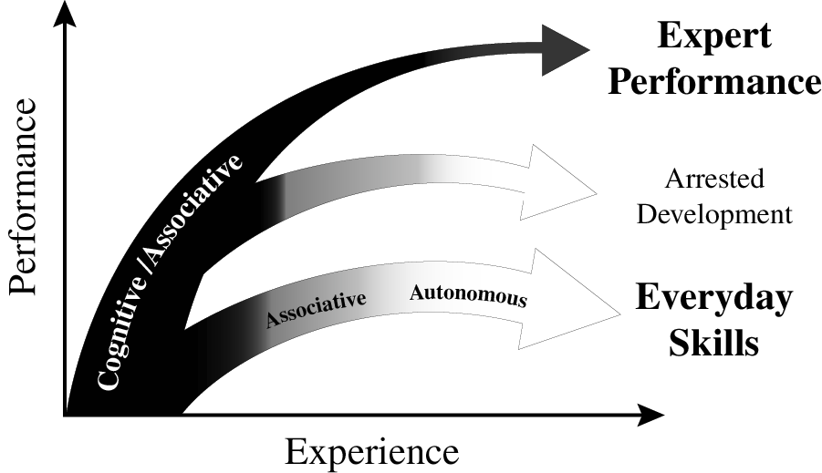
experience & variety of outcomes
Ericsson K. Anders. (2013). "The science of human excellence meets psychotherapy.” lecture at “Achieving clinical excellence conference.” May 17th, Amsterdam.

Slide 55
chess players/deliberate practice
it was time spent in “serious analysis of chess positions on one’s own” that was found to build expert performance (e.g. predicting key moves in games involving chess masters).
“active participation in chess tournaments” was unrelated to improvement, and “playing chess games outside chess tournaments” was a negative predictor of improvement.
the increased availability of chess computer programmes has been associated with a reduction in the time taken to become a grandmaster from about 10 years to 5 – 6 years.
there has also been the emergence of world class players from small countries (with little significant chess history) such as Norway (Magnus Carlsen).
Charness, N., et al. (1996). “The role of practice and coaching in entrepreneurial skill domains: An international comparison of life-span chess skill acquisition.” in K. A. Ericsson (ed.) “The road to excellence.” (51-80). Hillsdale, NJ: Lawrence Erlbaum.

Slide 56
chess players/deliberate practice
Charness, N., et al. (1996). “The role of practice and coaching in entrepreneurial skill domains: An international comparison of life-span chess skill acquisition.” in K. A. Ericsson (ed.) “The road to excellence.” (51-80). Hillsdale, NJ: Lawrence Erlbaum.

Slide 57
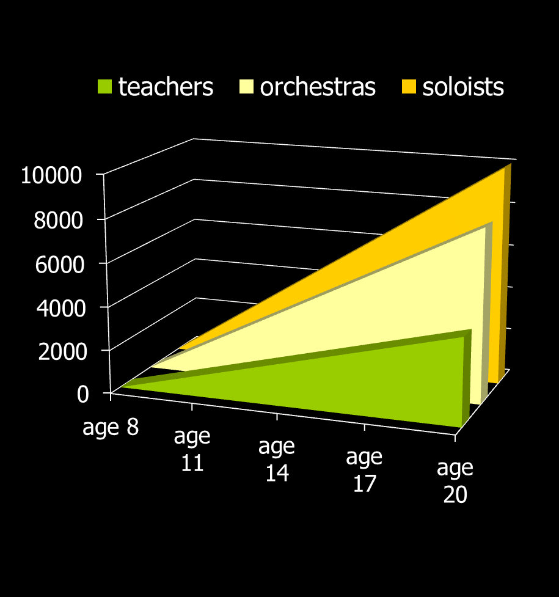
musicians & deliberate practice
classic early study on 20 yr old
violin students at the renowned
Music Academy of West Berlin
painstaking series of interviews
students sorted into 3 groups by professors’ assessments and success in open competitions
groups indistinguishable by average age of starting violin (age 8), average age at which decided to become musicians (just before age 15), number of teachers, etc. etc.
what stood out dramatically were the differences in hours spent practising – with no exceptions!
Ericsson, K. A., Krampe, R. T. & Tesch-Romer, C. (1993). “The role of deliberate practice in the acquisition of expert performance." Psychol Review 100(3): 363-406.

Slide 58
maintaining expertise
"If I don't practice one day, I know it; two days, the critics know it; three days, the public knows it.“ Jascha Heifetz
Krampe, R. T. and K. A. Ericsson (1996). "Maintaining excellence: Deliberate practice and elite performance in young and older pianists." J Exp Psychol Gen 125(4): 331-359. Two studies investigated the role of deliberate practice in the maintenance of cognitive-motor skills in expert and accomplished amateur pianists. Older expert and amateur pianists showed the normal pattern of large age-related reductions in standard measures of general processing speed. Performance on music-related tasks showed similar age-graded decline for amateur pianists but not for expert pianists, whose average performance level was only slightly below that of young expert pianists. The degree of maintenance of relevant pianistic skills for older expert pianists was predicted by the amount of deliberate practice during later adulthood. The role of delib-erate practice in the active maintenance of superior domain-specific performance in spite of general age-related decline is discussed.

Slide 59
experience & variety of outcomes
Ericsson K. Anders. (2013). "The science of human excellence meets psychotherapy.” lecture at “Achieving clinical excellence conference.” May 17th, Amsterdam.

Slide 60
psychotherapy/deliberate practice
17 therapists & 1,632 clients were studied – therapists were classified into four quartiles depending on their effectiveness.
as expected – qualifications, profession, experience, age, and gender were found to be unrelated to effectiveness.
fascinatingly, when asked about their use of client feedback, more successful therapists were much more likely to report being “surprised” by it – possibly a measure both of how well they had “set up” the feedback & of their openness/receptivity
also significant was their answer to the question: “How many hours per week (on average) do you spend alone seriously engaging in activities related to improving your therapy skills in the current year?” – the quartiles answered on average 7.39 (1st quartile); 4.13 (2nd); 2.00 (3rd) & 0.50 hours (4th quartile).
Chow, D. L., et al. (2015). "The role of deliberate practice in the development of highly effective psychotherapists." Psychotherapy (Chic) 52(3): 337-345.

Slide 61
psychotherapy/deliberate practice
“solitary activities” included ”reviewing therapy recordings alone, reviewing difficult/challenging cases alone, mentally running through & reflecting on past sessions in one’s mind, mentally running through & reflecting on what to do in future sessions, writing down reflections of past sessions, writing down plans for future sessions, viewing master therapist videos with the aim of developing specific therapeutic skills as a therapist, reading case examples (e.g. narratives, transcripts, case studies), reading of journals pertaining to psychotherapy & counselling, reading/re-reading of core counselling & therapeutic skills in psychotherapy.”
Chow, D. L., et al. (2015). "The role of deliberate practice in the development of highly effective psychotherapists." Psychotherapy (Chic) 52(3): 337-345.

Slide 62
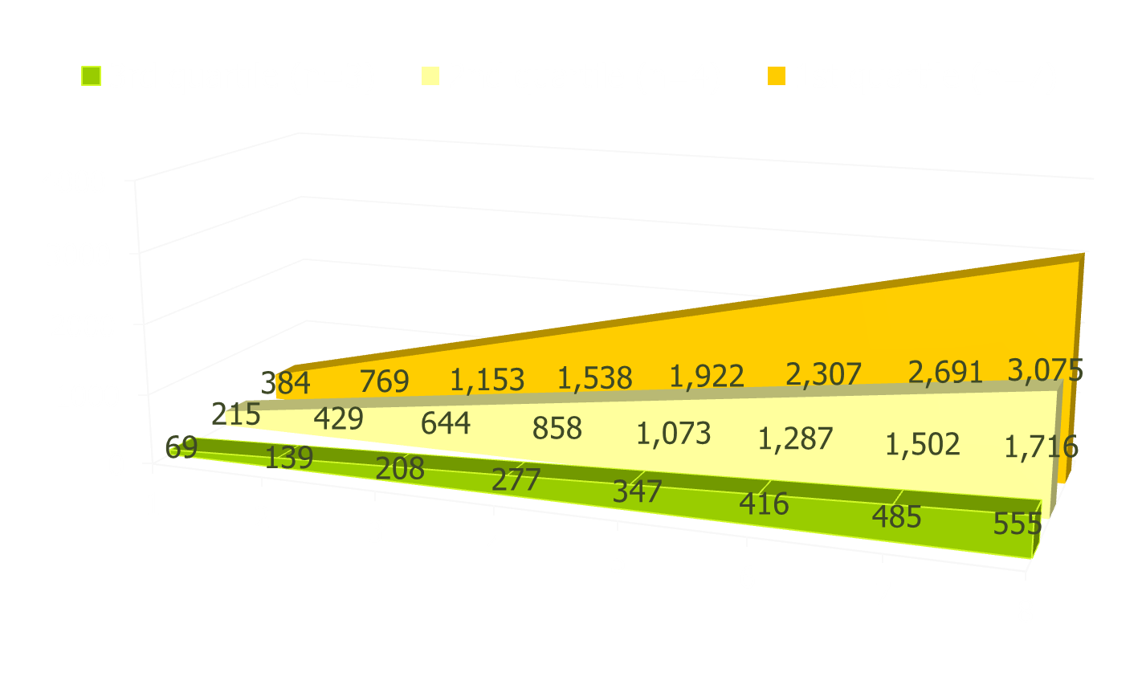
psychotherapy/deliberate practice
cumulative time spent in solitary practice over the first eight years of work as a psychotherapist

Slide 63
design & sequencing of training
ideally one monitors current performance & then designs specific individualized training activities: there is relevance here both for psychotherapists & clients.
Ericsson K. Anders. (2013). "The science of human excellence meets psychotherapy.” lecture at “Achieving clinical excellence conference.” May 17th, Amsterdam.

Slide 64
designing optimal level of practice
Ericsson K. Anders. (2013). "The science of human excellence meets psychotherapy.” lecture at “Achieving clinical excellence conference.” May 17th, Amsterdam.

Slide 65
developing expertise research
clarify overall starting point and overall goal – an obvious example is an aim to improve the proportion of clients who get to “recovery”.
choose an important sub-goal that will be a good building block in reaching the overall goal.
again clarify one’s starting point and what the targeted sub-goal end state will look like.
deliberate practice of sub-goal building block
fast, accurate feedback, the challenge repeated many times, gradual incremental progress
select further building block sub-goals to work on
monitor progress to main over-arching goal
… badminton example!

Slide 66
where should therapists focus?
common factors quality relationship, good goal agreement, confidence in methods
specific factors appropriate evidence based therapy, skilfully executed & supervised
Both camps can potentially make considerable gains in the results they achieve through better understanding and application of research on how individuals develop expertise – careful, measured assessment of one’s base-line; identification of key areas to work on; clarity about what better performance will look like; repeated, focused practice with rapid feedback; monitoring of whether performance improves & skilled supervision/mentoring

Slide 67
four suggestions for ways out of our impasse
identification and study of highly successful therapists’ methods and characteristics
routine outcome monitoring to encourage alerts and problem-solving if one is going off track
teaching & specific training in ‘facilitative interpersonal skills’
lessons from emerging research on how people develop excellence

Slide 68
exploring a couple of areas
a blast through the current rather shocking state of psychotherapy
brief discussion of four possible overlapping responses I’m exploring

Slide 69

revolution not just evolution
the implications of a large & growing body of research are huge for the whole field of psychotherapy:
initial selection
education & training
outcome monitoring
supervision & cpd

Slide 70

let’s make our own roads!
© Copyright 2012, Erik Johansson

