Slide 1
general orientation
looking at diet and dependencies/addictions
the crucial importance of willpower, self-control, grit and conscientiousness
introducing wooping, mental contrasting and implementation intentions

Slide 2
course outline/our journey
values, self-determination
mindset, exercise & sleep
willpower, diet, dependencies
mindbus & coping responses
savouring & gratitude
work, expertise, strengths
dunbar, roles, needs, dyads
nourishing, conflict, wisdom
groups, weak ties, resonance
review & stepping forward

Slide 3

good food is crucial for both physical & psychological health

Slide 4

diet & mortality
“more people die annually from cvd’s than from any other cause” WHO, 2016
“suboptimal intake of dietary factors associ-ated with 45% of (US) cardiometabolic deaths”
Micha, R., et al. (2017). "Association between dietary factors and mortality from heart disease, stroke, and type 2 diabetes in the USA.” JAMA 317(9): 912-924.

Slide 5
mediterranean diet & overall health
Stefler, D., et al. (2017). "Mediterranean diet score and total and cardiovascular mortality: the HAPIEE study." Eur J Nutr 56(1): 421-429.
Tong, T. Y., et al. (2016). "Prospective association of the Mediterranean diet with cardiovascular disease incidence and mortality." BMC Med 14(1): 135.
Wang, X., et al. (2014). "Fruit and vegetable consumption and mortality from all causes, cardiovascular disease, and cancer: systematic review." BMJ 349.
Chen, G.-C., et al. (2016). "Whole-grain intake and total, cardiovascular, and cancer mortality: a systematic review.” Am J Clin Nutr 104(1): 164-172.
Zhao, L. G., et al. (2016). "Fish consumption and all-cause mortality: a meta-analysis of cohort studies." Eur J Clin Nutr 70(2): 155-161.
Mayhew, A. J., et al. (2016). "A systematic review & meta-analysis of nut consum-ption & incident risk of CVD and all-cause mortality." Br J Nutr 115(2): 212-225.
Esteban-Cornejo, I., et al. (2016). "Adherence to the Mediterranean diet and academic performance in youth." Eur J Nutr 55(3): 1133-1140.
García-Esquinas, E., et al. (2016). "Consumption of fruit and vegetables and risk of frailty: a dose-response analysis." Am J Clin Nutr 104(1): 132-142.
Knight, A., et al. (2016). "Is the Mediterranean diet a feasible approach to preserving cognitive function & reducing risk of dementia?" Age Res Rev 25: 85.
Bo, S., et al. (2016). "Predictive role of the Mediterranean diet on mortality in individuals at low cardiovascular risk." J Transl Med 14: 91.

Slide 6
mediterranean diet & mental health
Lai, J. S., et al. (2014). "A systematic review & meta-analysis of dietary patterns and depression in community-dwelling adults." Am J Clin Nutr 99(1): 181-197.
Slyepchenko, A., et al. (2017). "Gut microbiota, bacterial translocation, & inter-actions with diet: pathophysiological links between major depressive disorder & non-communicable medical comorbidities." Psychother Psychosom 86(1): 31-46.
Parker, G. B., et al. (2017). "Vitamin D & depression." J Affect Disord 208: 56-61.
Esteban-Cornejo, I., et al. (2016). "Adherence to the Mediterranean diet and academic performance in youth." Eur J Nutr 55(3): 1133-1140.
Opie, R. S., et al. (2017). "Dietary recommendations for the prevention of depression." Nutr Neurosci 20(3): 161-171.
Yary, T., et al. (2016). "Dietary magnesium intake & the incidence of depression: A 20-year follow-up study." Journal of Affective Disorders 193: 94-98.
Martinez-Gonzalez, M. A. and A. Sanchez-Villegas (2016). "Food patterns and the prevention of depression." Proc Nutr Soc 75(2): 139-146.
Hayward, J., et al. (2016). "Lifestyle factors and adolescent depressive symptomatology: Associations and effect sizes of diet, physical activity and sedentary behaviour." Aust N Z J Psychiatry 50(11): 1064-1073.
Dash, S. R., et al. (2016). "Diet and common mental disorders: the imperative to translate evidence into action." Frontiers in Public Health 4: 81.
Chang, S.-C., et al. (2016). "Dietary flavonoid intake and risk of incident depression in midlife and older women." Am J Clin Nutr 104(3): 704-714.

Slide 7
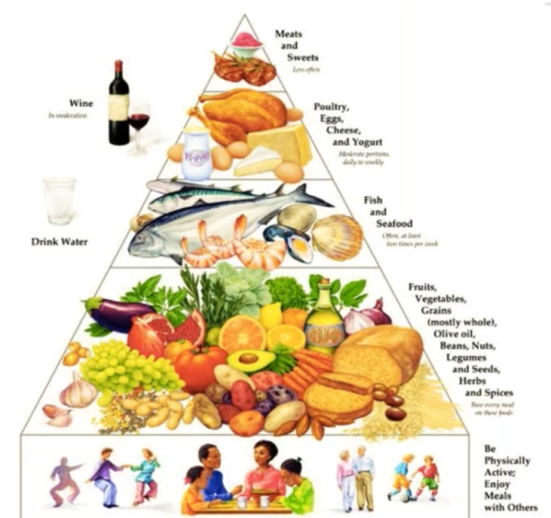
dietary treatment of depression
67 enrolled (48 female); 56 completed 12 weeks
46 already on medication, 30 having psychotherapy and 21 were using both
33 to dietary intervention, 34 to social support control
madrs depression scored dropped from ~26 to ~14 in diet group & from ~25 to ~21 in control – with similar results for anxiety
this is a highly significant difference – p < 0.001
Jacka, F., O’Neil, A., Opie, R. et al (2017). ”A randomised controlled trial of dietary improvement for adults with major depression (the ‘SMILES’ trial).” BMC Medicine 15:23.

Slide 8
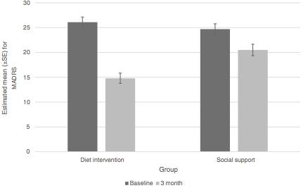
12 week reduction in depression
MADRS (depression) scores for dietary support & social support groups at baseline and at endpoint.
p < 0.001. Effect size: Cohen’s d = -1.16.

Slide 9
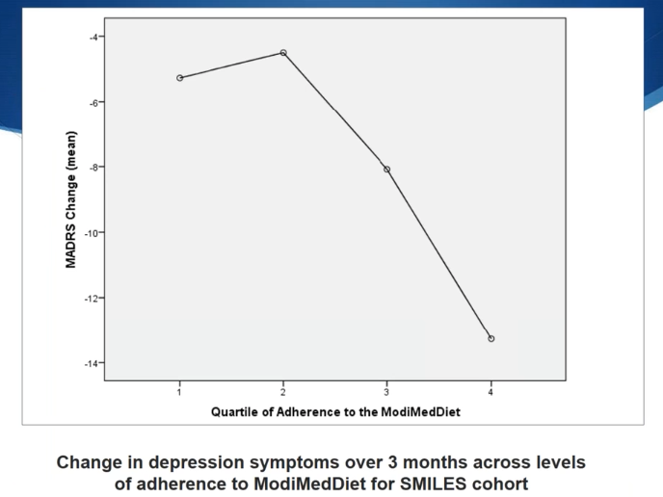
better adherence better results

Slide 10
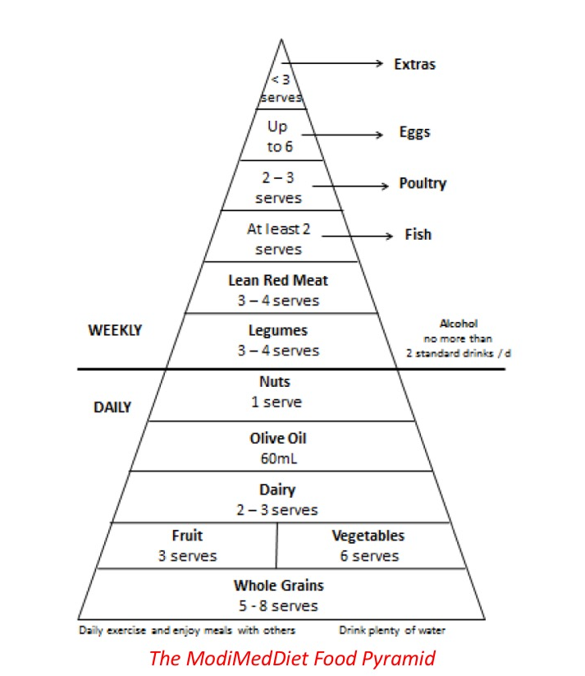
© 2012 rachelle s opie
the dietary intervention used in the very successful SMILES study

Slide 11
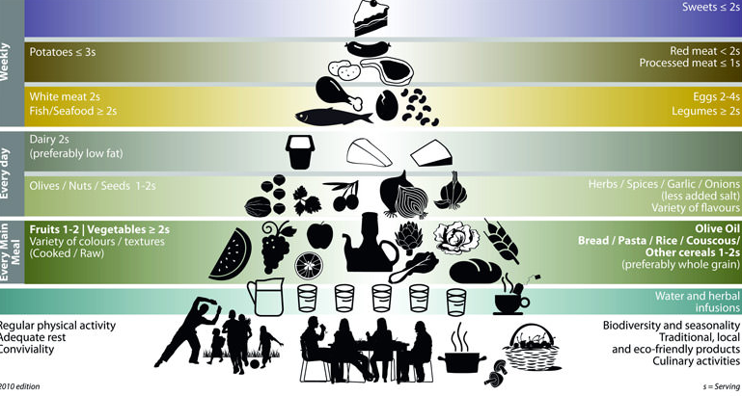
Bach-Faig, A., et al. (2011). "Mediterranean diet pyramid today. Science and cultural updates." Public Health Nutrition 14(12A): 2274-2284.

Slide 12
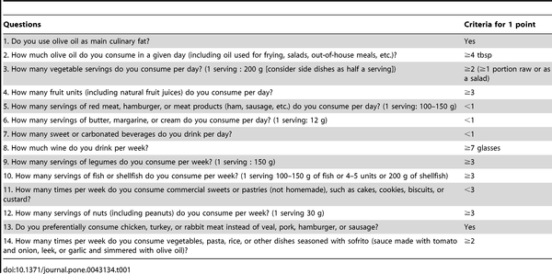

Table 1. Validated 14-item Questionnaire of Mediterranean diet adherence.
Martínez-González MA, García-Arellano A, Toledo E, Salas-Salvadó J, Buil-Cosiales P, et al. (2012) A 14-Item Mediterranean Diet Assessment Tool and Obesity Indexes among High-Risk Subjects: The PREDIMED Trial. PLOS ONE 7(8): e43134. doi:10.1371/journal.pone.0043134
http://journals.plos.org/plosone/article?id=10.1371/journal.pone.0043134

Slide 13
dangers of alcohol
(Available in free full text) Background Alcohol use is a leading risk factor for death and disability, but its overall association with health remains complex … we generated improved estimates of alcohol use and alcohol-attributable deaths and disability-adjusted life-years (DALYs) for 195 locations from 1990 to 2016 ... Findings Globally, alcohol use was the seventh leading risk factor for both deaths and DALYs in 2016, accounting for 2·2% (95% uncertainty interval [UI] 1·5–3·0) of age-standardised female deaths and 6·8% (5·8–8·0) of age-standardised male deaths. Among the population aged 15–49 years, alcohol use was the leading risk factor globally in 2016, with 3·8% (95% UI 3·2–4·3) of female deaths and 12·2% (10·8–13·6) of male deaths attributable to alcohol use. For the population aged 15–49 years, female attributable DALYs were 2·3% (95% UI 2·0–2·6) and male attributable DALYs were 8·9% (7·8–9·9). The three leading causes of attributable deaths in this age group were tuberculosis (1·4% [95% UI 1·0–1·7] of total deaths), road injuries (1·2% [0·7–1·9]), and self-harm (1·1% [0·6–1·5]). For populations aged 50 years and older, cancers accounted for a large proportion of total alcohol-attributable deaths in 2016, constituting 27·1% (95% UI 21·2–33·3) of total alcohol-attributable female deaths and 18·9% (15·3–22·6) of male deaths. The level of alcohol consumption that minimised harm across health outcomes was zero (95% UI 0·0–0·8) standard drinks per week. Interpretation Alcohol use is a leading risk factor for global disease burden and causes substantial health loss. We found that the risk of all-cause mortality, and of cancers specifically, rises with increasing levels of consumption, and the level of consumption that minimises health loss is zero. These results suggest that alcohol control policies might need to be revised worldwide, refocusing on efforts to lower overall population-level consumption.
GBD Alcohol Collaborators (2018). "Alcohol use and burden for 195 countries and territories, 1990-2016: a systematic analysis for the Global Burden of Disease Study 2016." Lancet Aug 23rd

Slide 14
drugs ordered by overall harm scores
Nutt, D. J., et al. (2010). "Drug harms in the UK: a multicriteria decision analysis." Lancet 376(9752): 1558-1565.

Slide 15
exercise
four foundational lifestyle practices
managing these 4 foundational practices well gives us so much more vitality and wellbeing … as well as longer healthier lives
good self-control helps us manage these 4 practices well … and managing them well feeds back to build our self-control
diet
dependencies include sugar alcohol and smoking as well as legal & illegal drugs
depend-encies
sleep

Slide 16
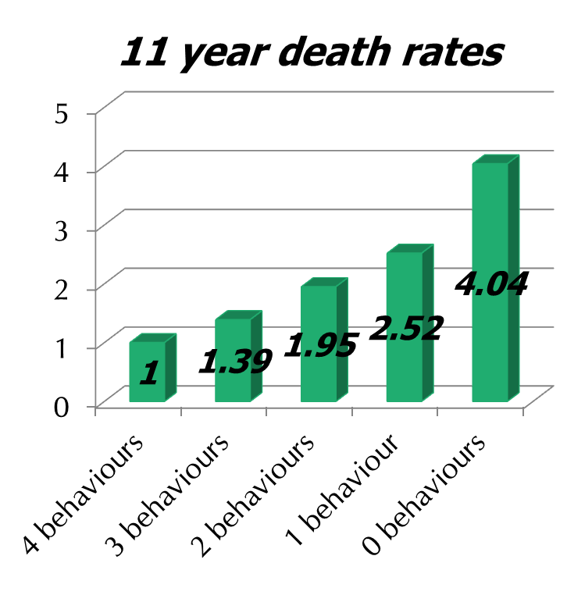
do you want to be 14 yrs younger?
20,224 UK adults
aged 45 to 79
no initial cancer/CHD
health behaviours rated
    not smoking
    physically active
    at least 5 fruit & veg daily
    1-14 alcohol units weekly
Khaw K-T, et al. “Combined impact of health behaviours …” PLoS Med 2008;5(1):e12

Slide 17
willpower
can do, want to, will do
mindset
autonomous not controlled
growth not fixed
motivation
strong not weak

Slide 18
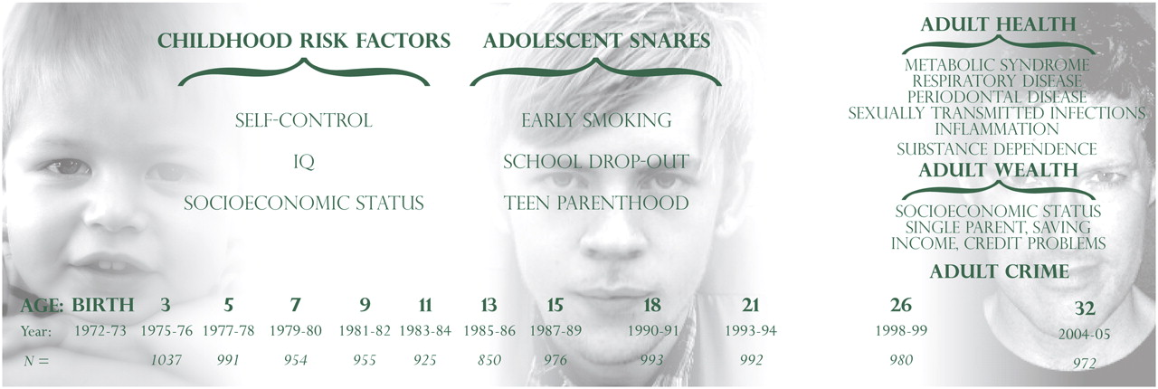
design of the dunedin multidisciplinary
health and development study
Moffitt T E et al. PNAS 2011;108:2693-2698
©2011 by National Academy of Sciences
Notes:
Design of the Dunedin Multidisciplinary Health and Development Study.

Slide 19
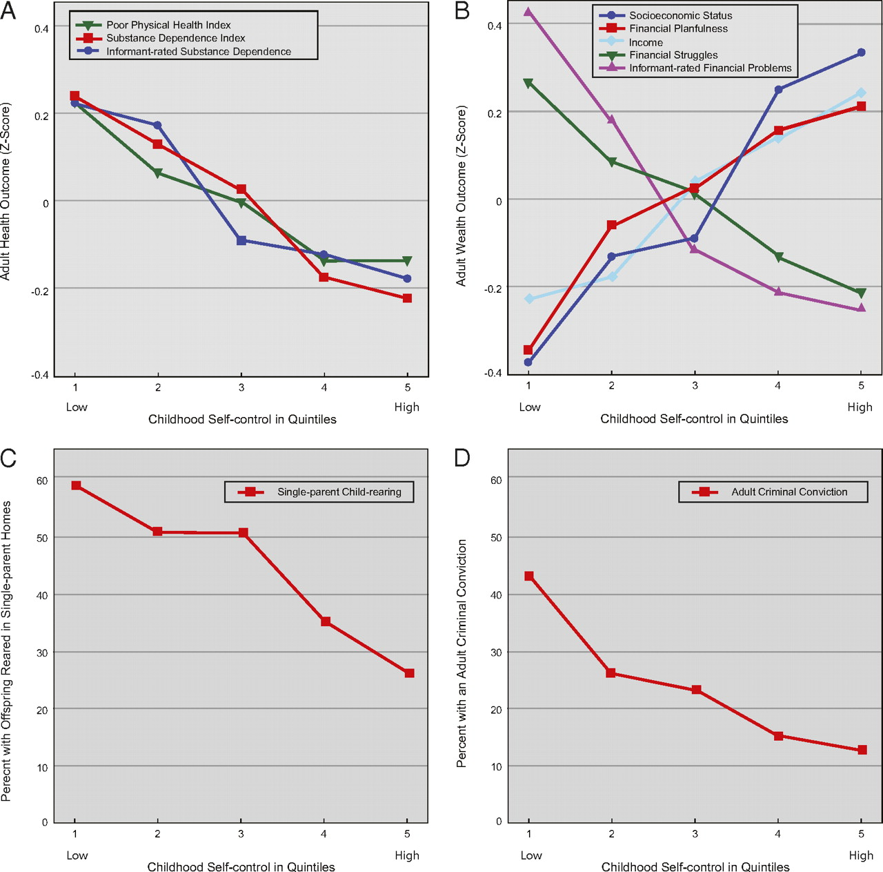
self-control gradient
poor physical health index
substance dependence index
informant substance dependence
socioeconomic status
financial planfulness
income
financial struggles
informant financial problems
single-parent child-raising
adult criminal conviction
Moffitt T E et al. PNAS 2011;108:2693-2698
©2011 by National Academy of Sciences
Notes:
Self-control gradient. Children with low self-control had poorer health (A), more wealth problems (B), more single-parent child rearing (C), and more criminal convictions (D) than those with high self-control.

Slide 20
balance cool ‘know’ & hot ‘go’ systems
cool cognitive ‘know’ system:
cognitive, slow, strategic, emotionally neutral, flexible, integrated, coherent,
seat of self-control & self-regulation
hot emotional ‘go’ system:
basis of emotionality, fears as well as passions,
impulsive & reflexive
Metcalfe, J. and W. Mischel (1999). "A hot/cool-system analysis of delay of gratification: dynamics of willpower." Psychological review 106(1): 3-19.

Slide 21
general orientation
looking at diet and dependencies/addictions
the crucial importance of willpower, self-control, grit & conscientiousness
introducing wooping, mental contrasting and implementation intentions

Slide 22
willpower
getting it done
wooping:
mental contrasting & implementation intentions
deliberate practice:
repeated, stretching feedback-informed
building block work
goals

Slide 23
Gabriele Oettingen’s technique of ‘WOOPing’ – Wish, Outcome, Obstacle, Plan – builds on the many research studies showing the value of both ‘Mental Contrasting’ and ‘Imple-mentation Intentions’ for achieving challenging goals

