Slide 1
compassion
james hawkins, goodmedicine.org.uk
edinburgh university ‘collider’, 2nd june ‘17

Slide 2
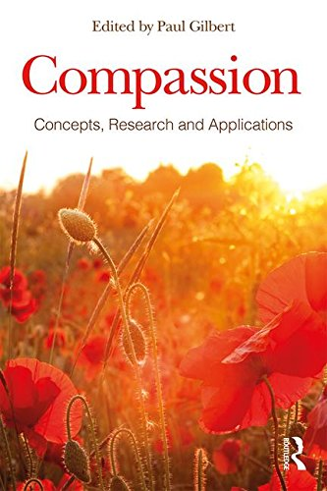
some questions
what?
why?
how?
so …?
published 4th may 2017

Slide 3
what?
Paul Gilbert, in his recent overview, comments “compassion has many textures and definitions … we may think of it as a particular feeling that arises, a motivation to be helpful, a listing of various attributes“
feeling
sensitivity
“a sensitivity to suffering in self and others with a commitment to try to alleviate and prevent it”
motivation
action
Gilbert P. “Compassion: definition and controversies”
in P. Gilbert (ed) “Compassion: concepts, research and applications”
Routledge: London & New York, 2017

Slide 4
sensitivity/feeling/motivation/action
“There isn’t any formula or method. You learn to love by loving – by paying attention and doing what one discovers has to be done.”
Aldous Huxley

Slide 5
why?
Hare, B. (2017). "Survival of the friendliest: homo sapiens evolved via selection for prosociality." Annual Rev Psychol 68: 155-186.
“Comparisons with nonhuman apes point to our early-emerging co-operative-communicative abilities as crucial … these early-emerging social skills evolved when natural selection favored increased in-group prosociality over aggression in late human evolution.”
Mikulincer, M. & Shaver, P. R. “An attachment perpective on compassion and altruism.”
in P. Gilbert (ed) “Compassion: concepts, research and applications” Routledge: London & New York, 2017.
“Individual differences in attachment orientations explain variations in compassion for, and caregiving to, needy relationship partners … we review empirical evidence that extends the study of attachment-caregiving links to global prosocial tendencies.”

Slide 6
“being isolated is equivalent to 15 cigarettes per day”
Bosely S. Duncan Selbie (head of Public Health England): “Being isolated is equivalent to 15 cigarettes a day.” Guardian 2013; 12/3.
Numerous meta-analyses highlight poor social connection as a health & mortality risk comparable to traditional factors such as smoking, obesity, high blood pressure, lack of exercise, and so on …
Holt-Lunstad, J., et al. (2015). "Loneliness and social isolation as risk factors for mortality: a meta-analytic review." Perspect Psych Science 10: 227-237.
Pantell, M., et al. (2013). "Social isolation: A predictor of mortality comparable to traditional clinical risk factors." Am J Pub Health: e1-e7.
Oishi, S. and U. Schimmack (2010). "Residential mobility, well-being, and mortality." J Pers Soc Psychol 98(6): 980-994.
Barbour, V., et al. (2010). "Social relationships are key to health, and to health policy." PLoS Med 7(8): e1000334.

Slide 7
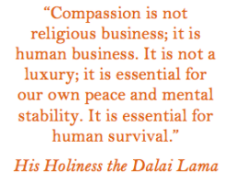
how?
Crocker, J., et al. (2017). "Social motivation: costs and benefits of selfishness and otherishness." Annu Rev Psychol 68: 299-325.
“We examine recent evidence on the consequences of selfishness and otherishness for psychological well-being, physical health, and relationships ... Then, because the behaviors of giving and taking can be motivated either by selfish or otherish concerns, we next consider the costs and benefits of the motivation underlying giving and taking … We focus on mechanisms identified in research, including intra-psychic mechanisms such as positive and negative affect, self-esteem and self-efficacy, a sense of meaning and purpose in life, and a sense of connectedness to or isolation from others, as well as interpersonal processes such as reciprocation of support and responsiveness.”

Slide 8
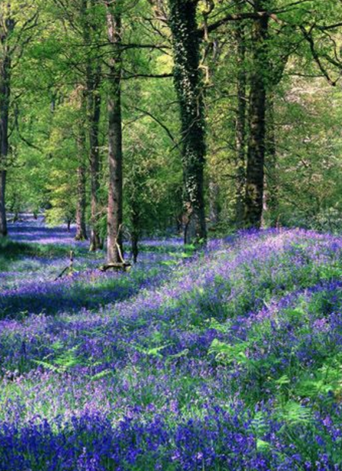
flourishing in
the ecosystem
individual
group
“The creature that wins against its environment, destroys itself”
Gregory Bateson
organization
town
country
planet

Slide 9
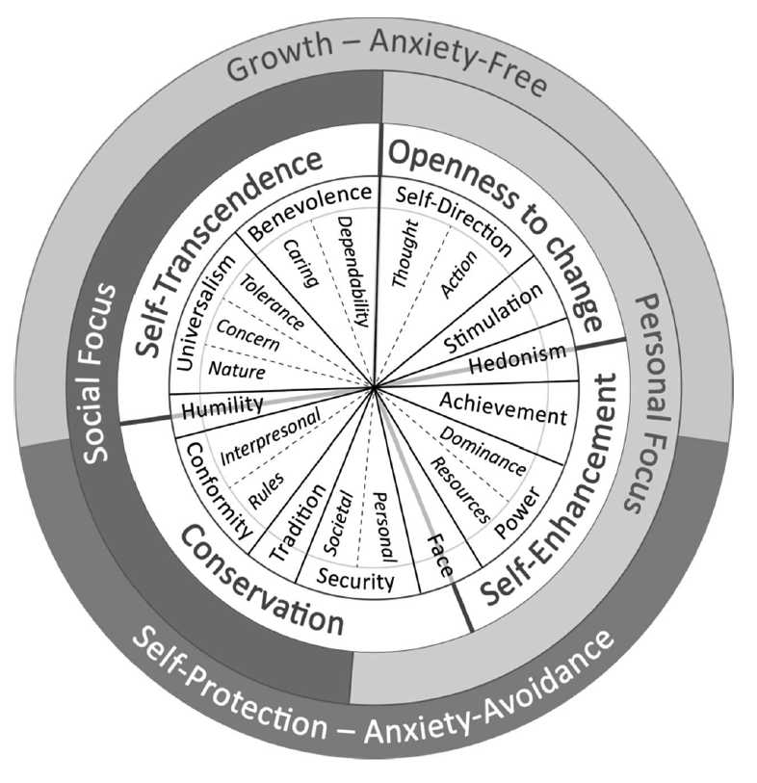
“Average value hierarchies of representative and near representative samples from 13 nations exhibit a similar pattern that replicates with school teachers in 56 nations and college students in 54 nations. Benevolence, self-direction, and universalism values are consistently most important”
Schwartz, S. H. & A. Bardi (2001). "Value hierarchies across cultures:
Taking a similarities perspective." J Cross-Cultural Psychology 32: 268-290

Slide 10
Schwartz, S. & K. Boehnke (2004). "Evaluating the structure of human values with confirmatory factor analysis." J Research in Personality 38(3): 230-255

Slide 11
the wonderful work of tania singer
“the resource project”
Kok, B. E. & T. Singer (2017). "Effects of contemplative dyads on engagement & perceived social connectedness over 9 months of mental training: A randomized clinical trial." JAMA Psychiatry 74(2): 126-134.
Kok, B. E. and T. Singer (2017). "Phenomenological fingerprints of four meditations: differential state changes in affect, mind-wandering, meta-cognition, and interoception before and after daily practice across 9 months of training." Mindfulness (N Y) 8(1): 218-231.
“If you want others to be happy, practice compassion.
If you want to be happy, practice compassion.”
Dalai Lama
Engen, H. G. and T. Singer (2015). "Compassion-based emotion regulation up-regulates experienced positive affect and associated neural networks." Social Cognitive and Affective Neuroscience 10(9): 1291-1301.
Leiberg, S., Klimecki, O. and T. Singer (2011) "Short-term compassion training increases prosocial behavior in a newly developed prosocial game." PLoS ONE 6(3): e17798.

Slide 12
jennifer crocker’s great “self & social motivation lab”
Crocker, J., et al. (2017). "Social motivation: costs and benefits of selfishness and otherishness." Annu Rev Psychol 68: 299-325.
Crocker, J. and Canevello, A. (2017). ”Egosystem and ecosystem: motivational orientations of the self in relation to others.” in K. Brown and M. Leary (eds) “The Oxford Handbook of Hypo-egoic Phenomena.” NY: OUP.
“Wisdom, compassion & courage are the three universally recognized moral qualities of men.”
Confucius
Abelson, J. L., et al. (2014). "Brief cognitive intervention can modulate neuroendocrine stress responses to the Trier Social Stress Test: buffering effects of a compass-ionate goal orientation." Psychoneuroendo 44: 60-70.
Crocker, J., et al. (2010). "Interpersonal goals & change in anxiety & dys-phoria in first-semester college students." J Pers Soc Psychol 98: 1009-24.

Slide 13
and many other teachers and research groups
Kirby, J. N. (2016). "Compassion interventions: The programmes, the evidence, and implications for research and practice." Psychology and Psychotherapy: Theory, Research and Practice.
“I expect to pass through life but once. If there-fore, there be any kindness I can show, or any good thing I can do to any fellow being, let me do it now, and not defer or neglect it, as I shall not pass this way again.”
William Penn
Raposa, E. B., et al. (2016). "Prosocial behavior mitigates the negative effects of stress in everyday life." Clinical Psychological Science 4(4): 691-698.
Wayment, H. A., et al. (2015). "Brief quiet ego contemplation reduces oxidative stress and mind-wandering." Frontiers in Psychology 6: 1481.
Trew, J. L. and L. E. Alden (2015). "Kindness reduces avoidance goals in socially anxious individuals." Motivation & Emotion 39: 892-907.
Fredrickson, B. L., et al. (2008). "Open hearts build lives: positive emotions, induced through loving-kindness meditation, build consequential personal resources." J Pers Soc Psychol 95(5): 1045-1062.

Slide 14
so …?
stages of change:
importance of motivation:
precontemplation
contemplation
preparation
action
maintenance
termination
controlled – external
controlled – introjected
autonomous – integrated
autonomous – intrinsic
some types of intervention:
compassion meditations
phone dyad exercises
written values affirmations
acts of kindness
deliberate goal orientation
visualisations
values contemplations
mental contrasting
implementation intentions
organisational/leadership

Slide 15
so …?
caution that we don’t try to reinvent the wheel
put up a request for help to the ‘compassionate mind’ google group
write to research teams who may already have explored using compassion-based interventions for university students

Slide 16
so …?
precontemplation:
posters, print & online articles & lectures, social media – including via pre-arrival facebook contact,
recruiting & educating 2nd year ‘befriender’ students
action:
weekly classes – “flourishing the ecosystem!” (size, number?) compassion meditations, phone dyads, values affirmations, discussions, acts of kindness, mental contrasting, goal setting, implementation intentions
maintenance:
support/meditation groups, further trainings – including students supporting subsequent first years, outreach, volunteering, activism, organizational change work

Slide 17
some tentative answers
what?
why?
how?
so …?

Slide 18
“And in the end
the love you make
is equal to the love you take.”
Lennon/McCartney

Slide 19
“We who lived in concentration camps can remember the men who walked through the huts comforting others, giving away their last piece of bread. They may have been few in number, but they offer sufficient proof that everything can be taken from a man but one thing: the last of the human freedoms — to choose one's attitude in any given set of circumstances, to choose one's own way.” Viktor Frankl (1905-1997)

Slide 20
"Tell me the weight of a snowflake," a coal-mouse asked a wild dove. "Nothing more than nothing," came the answer.
"In that case, I must tell you a marvellous story," the coal-mouse said. "I sat on the branch of a fir, close to its trunk, when it began to snow – not heavily, not in a raging blizzard – no, just like in a dream, without a wound and without any violence. Since I did not have anything better to do, I counted the snowflakes settling on the twigs and needles of my branch. Their number was exactly 3,741,952. When the 3,741,953rd dropped onto the branch – nothing more than nothing, as you say – the branch broke off."
Having said that, the coal-mouse flew away.
The dove, an authority on this since the time of Noah, thought about the story for awhile, and finally said to herself, "Perhaps there is only one person's voice lacking for peace to come to the world.”
“New Fables: Thus Spoke the Caribou” Kurt Kauter

Slide 21
“A human being is a part of the whole, called by us the "Universe", a part limited in time and space. He experiences himself, his thoughts and feelings, as something separated from the rest – a kind of optical delusion of his consciousness. The delusion is a kind of prison for us, restricting us to our personal desires and to affection for a few persons nearest to us. Our task must be to free ourselves from this prison by widening the circle of compassion to embrace all living creatures and the whole of nature in its beauty.” Albert Einstein

