Slide 1
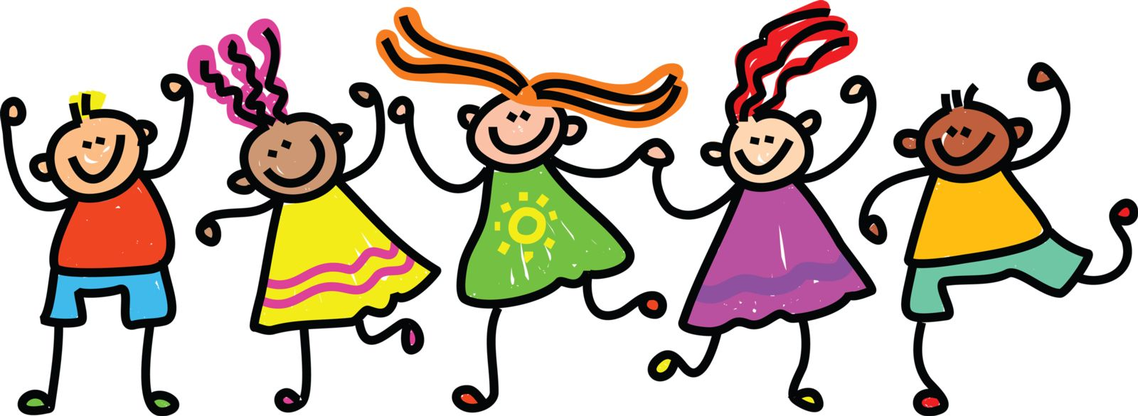
close relationships
james hawkins, goodmedicine.org.uk
glasgow caledonian, 29th january ‘19

Slide 2
areas we aim to explore
close relationships are so crucial for psychological & physical health & wellbeing
robin dunbar’s research on personal social networks
‘birds of a feather’ & ways of nourishing closer connections
the concerning frequency of conflict in close relationships
‘immediacy’ – mick cooper’s relational depth & barbara fredrickson’s micro-practices

Slide 3
activities: planned exercises
planned program for the day & personal areas we want to cover
reflection: physical, psychological & wellbeing effects of relationships
social network: support clique, sympathy group – identification
social time budget: size & how it is allocated – not too much/too little
social identity theory & our broader membership of various groups
personal example of relationship conflict & potential relevance of cognitive/emotional ibct approach
‘relational depth’ charting exercise
reflection on day & what’s most relevant professionally/personally

Slide 4
my general hopes for today: that you will all leave with …
increased awareness of the huge importance of relationships for health and wellbeing – and how relevant this is for us both professionally & personally
introduction to the intriguing & widely applicable evolutionary psychology ‘social brain’ network model
‘social identity theory’ and improved use of groups
further experience & reflection on work with conflict
present time exploration of both ‘relational depth’ & also of fredrickson’s ideas on ‘positivity resonance’
activity 1: what personal hopes do you have for today?

Slide 5
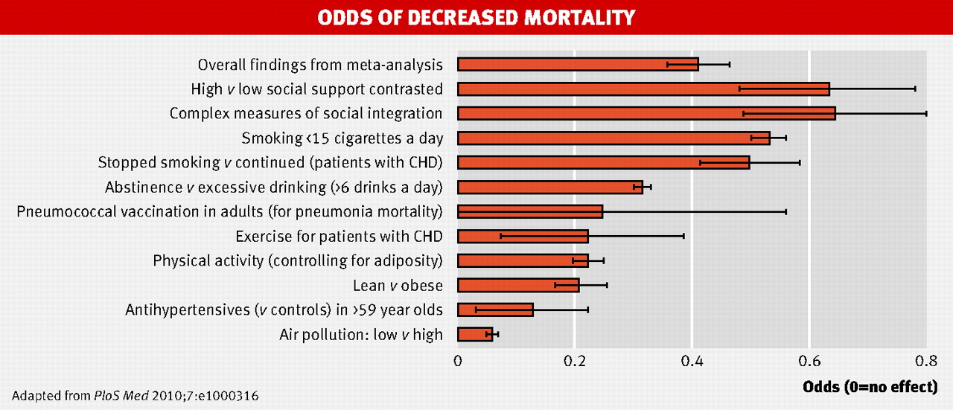
.
BMJ 2010;341:bmj.c4339
©2010 by British Medical Journal Publishing Group

Slide 6
four key psychological needs
autonomy
competence
autonomy – personal choice not compulsion by outside forces
competence – capable & effective not incompetent & inefficient
relatedness – regular emotional intimacy & shared activities not isolation & loneliness
beneficence – benevolence, being able to give not just self-centred
relatedness
beneficence
Reis, H. T., K. M. Sheldon, et al. (2000). Daily well-being: the role of autonomy, competence, and relatedness. Pers Soc Psychol Bull 26(4): 419-435. Sheldon, K. M., A. J. Elliot, et al. (2001). What is satisfying about satisfying events? Testing 10 candidate psychological needs. J Pers Soc Psychol 80(2): 325-39.

Slide 7
what makes for a good day?
people whose needs for autonomy, competence & relatedness are more satisfied experience greater well-being than those whose needs are less satisfied
at the same time, for each individual, days when these basic needs are more satisfied are experienced as better than days when the needs are less satisfied
it’s not just the total amount of need satisfaction, it’s also the balance that optimises well-being
Sheldon, K. M., R. Ryan, et al. (1996). What makes for a good day? Competence and autonomy in the day and in the person. Pers Soc Psychol Bull 22(12): 1270-1279.
Sheldon, K. M. and C. P. Niemiec (2006). It's not just the amount that counts: balanced need satisfaction also affects well-being. J Pers Soc Psychol 91(2): 331-41.

Slide 8
interpersonal psychotherapy
loss
conflict
transition
deficiency
Ravitz, P. and P. Watson (2014). "Interpersonal psychotherapy: Healing with a relational focus." Focus 12: 275-284.
Markowitz, J. C., et al. (2015). "Is Exposure Necessary? A Randomized Clinical Trial of Interpersonal Psychotherapy for PTSD." Am Journal of Psychiatry 172(5): 430-440.
Cuijpers, P., et al. (2016). "Interpersonal Psychotherapy for Mental Health Problems: A Comprehensive Meta-Analysis." Am Journal of Psychiatry 173(7): 680-687.

Slide 9
kendler et al life event research
1,082 pairs of female twins questioned about previous year
average age of these subjects was 30.1 years old
stressful life events and onset of major depression noted
9 events primarily involving the subject and 22 events primarily involving, or interacting with, someone in their social network were recorded
events most associated with subsequent depression onset in the next month are shown in the graph
those at lowest genetic risk of depression (co-monozygotic twin not depressed), probability of depression onset in next month was 0.5% with no severe event, and 6.2% with event
figures for those at highest genetic risk were 1.1% & 14.6%
Kendler KS, Kessler RC, Walters EE et al Stressful life events, genetic liability, and onset of an episode of major depression in women Am J Psychiatry 1995; 152: 832-42

Slide 10
increased chance depression onset
major money problem
serious illness
serious illness of close relative
loss of confidant
job loss
serious conflict close relative
serious problem in marriage
divorce or break-up
assault
death of
close relative
increased onset of major depression in month after significant life event compared with those suffering no such significant life events
Notes:
Ref [2313] - it is difficult to present results simply. there are so many ways of viewing the data eg. do we look only at completers or as with this graph at all those entering treatment. do we look at all patients en bloc or do we divide them by severity (and if so by what criterion - Global Assessment Scale, HRSD, BDI?). how do we assess outcome - HRSD, BDI etc?

Slide 11
activity 2: how are we doing?
what has particularly struck professionally and personally hearing these ‘facts & figures’ about the powerful physical, psychological and well-being effects of close relationships?

Slide 12
personal social networks
Dunbar, R. (1998). "The social brain hypothesis." Evolutionary Anthropology 6(5): 178–190.
Stiller, J. & R. I. M. Dunbar (2007). "Perspective-taking and memory capacity predict social network size." Social Networks 29(1): 93-104.
Powell, J. L., et al. (2010). "Orbital prefrontal cortex volume correlates with social cognitive competence." Neuropsychologia 48: 3554-3562.
Dunbar, R. I. M. (2014). "The social brain: psych-ological underpinnings and implications for the structure of organizations." Current Directions in Psychological Science 23(2): 109-114.
Roberts, S. B. & R. I. Dunbar (2015). "Managing relationship decay: network, gender, and contextual effects." Human Nature 26: 426-450.
Mac Carron, P., et al. (2016). "Calling Dunbar's numbers." Social Networks 47: 151-155.
particular thanks for the extensive research on social networks conducted by Robin Dunbar, Oxford professor of evolutionary psychology, & colleagues

Slide 13
support clique/closest relationships
the ‘support clique’ are the people who one would turn to in times of extreme social, emotional or financial distress – note too ‘broaden & build’
on average there are about 5 people in the ‘support clique’ – with a range from 0 to 15 and sometimes 1 or 2 who are especially close - there may be a trade-off between overall numbers & individual closeness
these very close relationships involve considerable ongoing commitment of time, energy & emotion, but they ‘repay’ with major benefits for physical health, emotional resilience & overall wellbeing
‘support clique’ relationships are typically characterised by high emotional closeness, trust & frequency of contact
10 =
intensely close/intimate
fascinatingly ‘support clique’ numbers are limited not only by available time but also by ‘mentalising ability’ (perspective –taking competence) & the associated size of one’s orbital prefrontal cortex
0 =
emotionally neutral

Slide 14
sympathy group/good relationships
on average – including those in the ‘support clique’ - there are roughly 15 people in the ‘sympathy group’ – they are not so deeply close as those who are also in the ‘clique’ and are probably seen about monthly rather than approximately weekly for the ‘clique’
the ‘sympathy group’ are described as people who would be ‘devastated’ by the death of someone else in the group
typically there are about 3 x as many people in the ‘sympathy group’ as in the ‘support clique’ – and in both there are usually a considerably higher proportion of same sex contacts; people from large families may not have much time/space left in their sympathy group for non-family friends
emotional closeness changes & it takes time & regular contact to maintain – this is especially true for non-family friendships
10 =
intensely close/intimate
although both ‘sympathy group’ & ‘support clique’ numbers are limited by available time – the size of the latter is also dependent on mentalising ability (perspective –taking competence), while the former possibly depends more on memory capacity
0 =
emotionally neutral

Slide 15
activity 3: identifying relationships
who would you currently put into your inner circle ‘support clique’? note whether they are kin (k), kin by couple relationship (ck) or non-related friend (f); local (l) or non-local (nl); how long known; and how emotionally close (e?)
the ‘support clique’ tend to be who you would turn to in a crisis & also you value your regular (at least weekly?) contact with them. in contrast you have contact with the ‘sympathy group’ maybe only monthly & they are also less close

Slide 16
affinity groups & active networks
on average there are about 150 people in a personal full ‘active network’ – with a natural range of approximately 100-250; it correlates with pre-industrial village size & earlier tribal size; the active network may well serve both territorial & mate-access functions
one’s full ‘active network’ is made up mostly of ‘acquaintances’ - all the people with whom one has a ‘personalized’ relationship and who one wants to maintain contact with
successive network layers increase in numbers by a factor of about 3, and tend to involve relationships that demand less time investment to maintain & that are less emotionally close – however different layers respond to different needs
the smaller – approximately 50 sized – affinity or foraging group probably primarily has an anti-predation function
10 =
intensely close/intimate
social identity theory (haslam, cruwys, et al) highlights the considerable health gains obtainable through identification & participation with a variety of groups, that may be populated by acquaintances rather than friends
0 =
emotionally neutral

Slide 17
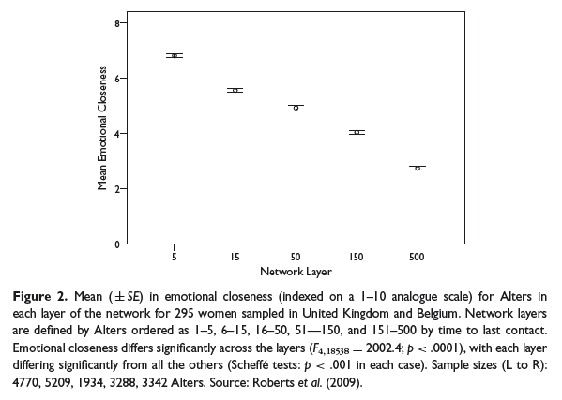
closeness varies by network layer
Sutcliffe, Dunbar et al, 2012

Slide 18
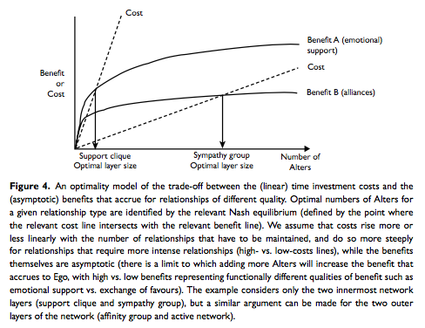
how spend our social time budget?
cross-cultural studies suggest a typical social time budget of ~3.5 hr per day
Sutcliffe, Dunbar et al, 2012

Slide 19
metaphors & mechanisms
mountain: - 5, 15, 50, 150 -
food: well balanced ‘diet’
garden: regular ‘watering’
music: how play together
attachment mentalising memory
mu-opioids orbital pfc capacity

Slide 20
activity 4: social time budget
relationships are a bit like food – we want good, well-balanced diets
our relationship networks are also gardens needing regular watering
and like mountains – are the layers a (1-2)/5/15/50/150 pattern?
typical ‘social time budgets’ are about 3½ hours per day – how is yours? is it too big or too small?
how do you allocate your ‘budget’ to the different layers of your network? is this a good spread?
how’s the ‘music’ – is the quality of the time you spend good?

Slide 21
do birds of a feather flock together?
surveyed: 226 UK working-age adults (115 males, 111 females; mean age 43, SD=10.8
asked to identify a couple of friends – 1 male & 1 female (not family) – in each of 3 ‘layers’
previous research has shown network layer tends to map onto frequency of contact
this study used layer 2 (sympathy) monthly; layer 4 (active social network) yearly; and layer 5 (total network) contacted every few years
Curry, O. and R. I. M. Dunbar (2013). "Do birds of a feather flock together?" Human Nature 24(3): 336-347.

Slide 22
asked which of 22 similarities they shared
asked “which of the following are true of your relationship?” share political views; share religious beliefs; share moral beliefs; share hobbies & interests; have the same friends; have similar personalities; from the same area; from the same school/college/university; work together/same workplace; speak the same language/dialect; share a sense of humor; support same sports team; like similar music; have similar fashion sense; are of the same ethnic group; have the same occupation; are members of the same club/association; are of the same class/socioeconomic status; have similar incomes; have similar levels of education/intelligence; are of the same generation/similar age; have the same sexual orientation (e.g. homosexual/heterosexual)

Slide 23
similarity & emotional closeness declined across the layers
similarity score ranged from 0 to 22
emotional closeness ranged from 1 (not at all close) to 10 ( extremely close)
 | layer 2 | layer 4 | layer 5
similarity | 10.5 | 8.6 | 7.6
closeness | 4.8 | 3.9 | 3.2

Slide 24
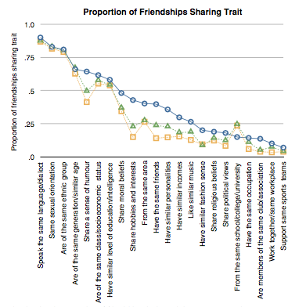

Slide 25
6 factors usually shared across all 3 personal network layers surveyed
these 6 commonly shared factors are predictable & possibly a bit concerning
speak the same language/dialect
same sexual orientation
same ethnic group
same generation/similar age
same class/socioeconomic status
similar level of intelligence/education

Slide 26
6 factors (plus contact frequency) most distin- -guished between layers
“the final model for emotional closeness shows 6 variables plus layer make unique significant positive contributions”
sense of humor
moral beliefs
hobbies/interests
similar personalities
taste in music
from same area

Slide 27
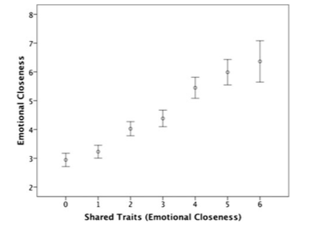
6 factor similarity tracks closeness

Slide 28
maybe these are useful indicators for potential future friendships?
6 factors usually shared across all 3 network layers surveyed: language/dialect, sexual orientation, ethnic group, generation/age, class/socioeconomic status, intelligence/education
6 factors (& contact frequency) distinguishing most between more or less emotional closeness: similar sense of humor, moral beliefs, hobbies/interests, personalities, taste in music, location

Slide 29
activities: planned exercises
planned program for the day & personal areas we want to cover
reflection: physical, psychological & wellbeing effects of relationships
social network: support clique, sympathy group – identification
social time budget: size & how it is allocated – not too much/too little
social identity theory & our broader membership of various groups
personal example of relationship conflict & potential relevance of cognitive/emotional ibct approach
‘relational depth’ charting exercise
reflection on day & what’s most relevant professionally/personally

Slide 30
social identity theory
Sani, F., et al. (2012). "Comparing social contact and group identification as predictors of mental health." Br J Social Psychology 51(4): 781-790.
Cruwys, T., et al. (2014). "Depression and social identity: an integrative review." Personality and Social Psychology Review 18(3): 215-238.
Haslam, S. A. (2014). "Making good theory practical: five lessons for an Applied Social Identity Approach to challenges of organizational, health, and clinical psychology." Br J Soc Psychol 53(1): 1-20.
Sani, F., et al. (2015). "Greater number of group identifications is associated with lower odds of being depressed: evidence from a Scottish community sample." Social Psychiatry and Psychiatric Epidemiology 50(9): 1389-1397
Sani, F., et al. (2015). "Greater number of group identifications is associated with healthier behaviour: Evidence from a Scottish community sample." Br J Health Psychology 20(3): 466-481.
Haslam, C., et al. (2016). "Groups 4 Health: Evidence that a social-identity intervention that builds and strengthens social group membership improves mental health." Journal of Affective Disorders 194: 188-195.
social identity
and groups network
ww.socialidentitynetwork.com

Slide 31
the six ‘rules’ of friendship
stand up for them when they’re absent
share important news with each other
trust and confide in each other
volunteer help when it would be useful
provide emotional support for each other
try to make each other happy
the six rules were derived from 4 studies involving British, Italian, Hong Kong and Japanese participants
Argyle, M. & M. Henderson (1984). "The rules of friendship." Journal of Social and Personal Relationships 1(2): 211-237.

Slide 32
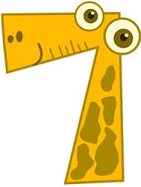
seven relationship competencies
communication
knowledge of partner
life skills
sex and romance
stress management
self-management
conflict resolution
maybe take the 10 minute 70 question free survey at myrelationshipskills.com
Epstein, R., et al. (2013). "Which relationship skills count most?" Journal of Couple & Relationship Therapy 12(4): 297-313.
Epstein, R., et al. (2016). "Which Relationship Skills Count Most? A Large-Scale Replication." Journal of Couple & Relationship Therapy 15(4): 341-356.

Slide 33
knowledge of partner: knowing how to have fun with one’s partner, knowing about his/her preferences, caring about one’s partners hopes and dreams, etc
communication: knowing how to listen, sharing one’s thoughts & feelings honestly, refraining from criticizing, etc
life skills: managing money responsibly, exercising & staying fit, being able to find & keep a job, etc
sex and romance: inquiring & caring about how to please one’s partner sexually, setting aside time for intimacy, staying attractive for one’s partner, etc
stress management: using imagery techniques, thought management techniques, planning & organizational skills, etc
self-management: knowing one’s strengths & weaknesses, striving to overcome weaknesses, identifying/reaching goals, etc
conflict resolution: staying focused on the topic, staying focused on the present, being ready to forgive or apologize, etc
f>m f<m

Slide 34
some intriguing take-away points
knowledge and communication emerged as particularly helpful ways of nourishing close relationships – this is probably true for good friendships as well as for couples
knowledge of partner: knowing how to have fun with one’s partner, knowing about his/her preferences, caring about one’s partners hopes and dreams, etc
communication: knowing how to listen, sharing one’s thoughts & feelings honestly, refraining from criticizing, etc
knowledge: finding out about, remembering & referring to important aspects of the other’s life seems important and learnable; communication: crucial as well, although maybe we should be cautious on our self-assessment here

Slide 35
knowledge/interest seems crucial
know their hopes & dreams
know how to have a fun time with them
regularly ask about their tastes, preferences & passions
listen & remember when they tell me about their problems
remember their birthday and other special days
know all about their family

Slide 36
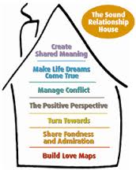
the ‘sound relationship house’
see the gottman institute at www.gottman.com

Slide 37
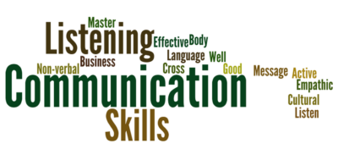
helpful communication central too
comfortable talking about my feelings
frequently encourage to express their views
always try to be honest
often ask for feedback
know how to describe my feelings accurately
praise & encourage far more often than criticize
try to make time for friendly conversation

Slide 38
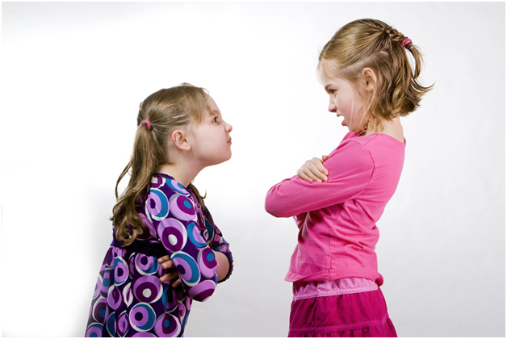
friendship & conflict
540 participants (only 112 were male)
all adults - 70% were aged between 18 & 38
363 were currently in a couple relationship
asked about ‘severe fallings out’ with people in their social network
last week/month/year
40% still not reconciled a year afterwards
conflicts with those who matter most to us in our personal social networks are surprisingly common
Dunbar, R. & A. Machin (2014). "Sex differences in relationship conflict and reconciliation." Journal of Evolutionary Psychology 12(2-4): 109-133.

Slide 39
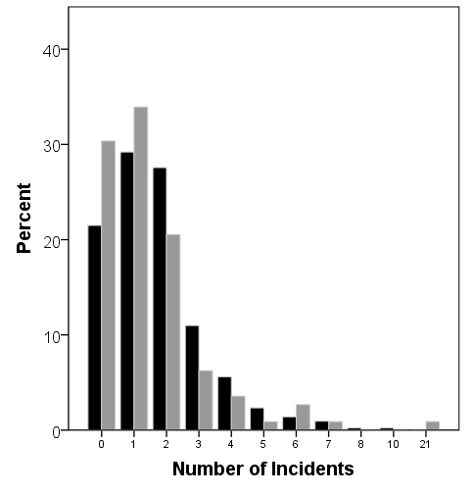
frequency of ‘severe falling out’
women: black columns
men: grey
columns
average of 1.67 episodes per person, but a high proportion were recent suggesting an underestimate for last year
Dunbar & Machin, 2014

Slide 40
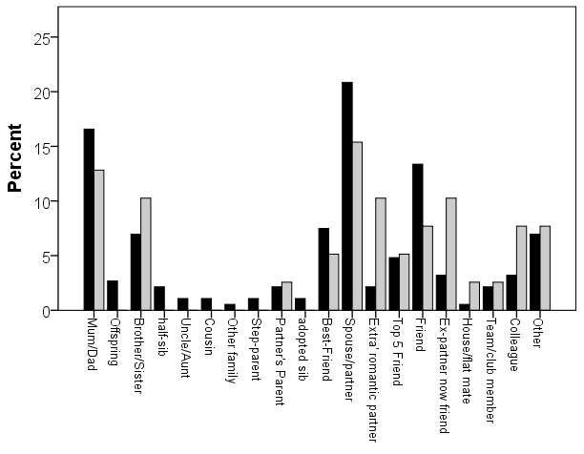
which relationships involved
women black,
men grey

Slide 41
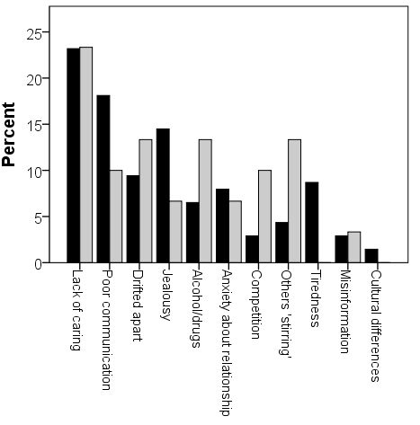
cause of ‘severe falling out’
women: black columns
men: grey
columns
cause was selected from a list of 14 possible choices
Dunbar & Machin, 2014

Slide 42
five principles of couples work
Andrew Christensen ‘A unified
‘protocol for couple therapy’
emphasize strengths & grow positive behaviours
modify emotion-driven maladaptive interactions
reasons for initial attraction to each other; assess & feedback strengths; encouragement of positive behaviour; learning from successful interactions; vulnerability behind demands & hostility
therapists may highlight & interrupt these patterns in session; at home, ‘time-outs’, mental contrasting & implementation intentions can all have a part to play
shared, non-blaming
dyadic, understanding
note importance of identifying & changing couples’ key distress-producing cause-effect chains
D: Differences
E: Emotional
sensitivities
E: External
circumstances
P: Patterns of
communication
cooperatively arrived at DEEP ‘reappraisal’: may involve an understanding that both partners are trying to meet valid needs but that how they’re doing this is unhelpfully coloured by their pasts
develop more adaptive communication skills
‘elephants’: problem-solving and intimacy
helping speakers become more ‘self-focused’ (less blaming of others, more disclosing own emotions & vulnerability); helping listeners become more ‘other focused’ (body language, standing ‘in the other’s shoes’, summarizing)
at the right time, it’s likely to be important to open up about any of a variety of potentially important avoided ‘elephant in the room’ topics; this can allow constructive joint problem-solving & deepen understanding & closeness

Slide 43
shared, non-blaming, dyadic model
Andrew Christensen ‘A unified protocol for couple therapy’
emphasize strengths & grow positive behaviours
modify emotion-driven maladaptive interactions
reasons for initial attraction to each other; assess & feedback strengths; encouragement of positive behaviour; learning from successful interactions; vulnerability behind demands & hostility
therapists may highlight & interrupt these patterns in session; at home, ‘time-outs’, mental contrasting & implementation intentions can all have a part to play
shared, non-blaming
dyadic, understanding
note importance of identifying & changing couples’ key distress-producing cause-effect chains
D: Differences
E: Emotional
sensitivities
E: External
circumstances
P: Patterns of
communication
cooperatively arrived at DEEP ‘reappraisal’: may involve an understanding that both partners are trying to meet valid needs but that how they’re doing this is unhelpfully coloured by their pasts
develop more adaptive communication skills
‘elephants’: problem- solving and intimacy
helping speakers become more ‘self-focused’ (less blaming of others, more disclosing own emotions & vulnerability); helping listeners become more ‘other focused’ (body language, standing ‘in the other’s shoes’, summarizing)
at the right time, it’s likely to be important to open up about any of a variety of potentially important avoided ‘elephant in the room’ topics; this can allow constructive joint problem-solving & deepen understanding & closeness

Slide 44
conflict reappraisal
jennifer crocker’s work at ohio state university highlights the negative personal & social outcomes of self-entitlement
jim mcnulty’s work at university of florida highlights that when there are significant relationship problems, ‘conflict’ may well be associated with better outcomes
describe a conflict from the point of view of a neutral, compass-ionate observer (see ‘startlingly effective’ handout) and what useful might they suggest could come from the conflict?
Finkel, E.J, Slotter, E.B., et al."A brief intervention to promote conflict reappraisal preserves marital quality over time." Psychol Sci 2013;24:1595-1601

Slide 45
activity 6: responding to conflict
describe the conflict from the point of view of a neutral, compassionate observer (see ‘startlingly effective’ handout) & what useful might they suggest could come from the conflict?
Finkel, E. J., E. B. Slotter, et al. (2013). "A brief intervention to promote conflict reappraisal preserves marital quality over time." Psychol Sci 24(8): 1595-1601
similar neutral, compassionate observer description of the conflict, but now using a mutually developed DEEP explanation (Differences, Emotional sensitivities, External circumstances, & Patterns of communication)
both IBCT & EFT therapists look for underlying (soft) primary emotions, ‘marinate’, explore links and ask about needs; partners too may be very moved by this
^{Christensen, A., Doss, B.D.} & Jacobson, N.S. (2014). ”Reconcilable differences (2nd ed.)” New York: Guilford Press
Johnson, S.M. (1996) “The practice of emotionally focused marital therapy: creating connection” Brunner/Mazel

Slide 46
integrative behavioural couple
therapy: 3 overlapping interventions
helpful
non-blaming understanding
deeper emotional connections
inner: empathy & compassion
improved practical strategies
outer: time- outs, communic-ation skills, etc
both inner & outer change interventions

Slide 47
metaphors & mechanisms
mountain: - 5, 15, 50, 150 -
food: well balanced ‘diet’
garden: regular ‘watering’
music: how play together
attachment mentalising memory
mu-opioids orbital pfc capacity

Slide 48
meeting deeply
it’s likely to be most helpful if this communication is held in a setting of goodwill for oneself & for the other person
expressivity
receptivity
to deepen communication it can be useful to be aware of any blocks in the four phases highlighted in this diagram and fifthly to monitor the overall quality of goodwill
meeting
deeply
note too the possible
value of tracking five aspects of emotion – the trigger, body response, impulse, verbal label & associated wish or need
after Bugental,
Greenberg & Cooper
receptivity
expressivity

Slide 49
activities: planned exercises
planned program for the day & personal areas we want to cover
reflection: physical, psychological & wellbeing effects of relationships
social network: support clique, sympathy group – identification
social time budget: size & how it is allocated – not too much/too little
social identity theory & our broader membership of various groups
personal example of relationship conflict & potential relevance of cognitive/emotional ibct approach
‘relational depth’ charting exercise
reflection on day & what’s most relevant professionally/personally

Slide 50
charting depth of connection
For each minute of your meeting, please put an ‘X’ in the box to indicate how deeply connected you feel with the other person. A rating of 0 indicates that you do not feel any interpersonal connection. A rating of 10 indicates that you feel very deeply connected.
0 = not at all connected
0
1
2
3
4
5
6
7
8
9
10
 | 1 | 2 | 3 | 4 | 5 | 6 | 7 | 8 | 9 | 10 | 11 | 12 | 13 | 14 | 15 | 16 | 17 | 18 | 19 | 20
depth of connection
10 = very deeply connected
time in minutes
adapted from Mick Cooper, 2010

Slide 51
practising ‘positivity resonance’
goodwill
sharing ‘positive’ emotion
synchronisation
aim for at least 3 ‘connections’ daily
scale record closeness & synchronisation
significant gains in ‘positivity ratio’
Barbara Fredrickson “Love 2.0” Plume, 2014

Slide 52
activities: planned exercises
planned program for the day & personal areas we want to cover
reflection: physical, psychological & wellbeing effects of relationships
social network: support clique, sympathy group – identification
social time budget: size & how it is allocated – not too much/too little
social identity theory & our broader membership of various groups
personal example of relationship conflict & potential relevance of cognitive/emotional ibct approach
‘relational depth’ charting exercise
reflection on day & what’s most relevant professionally/personally

Slide 53
my general hopes for today: that you will all leave with …
increased awareness of the huge importance of relationships for health and wellbeing – and how relevant this is for us both professionally & personally
introduction to the intriguing & widely applicable evolutionary psychology ‘social brain’ network model
‘social identity theory’ and improved use of groups
further experience & reflection on work with conflict
present time exploration of both ‘relational depth’ & also of fredrickson’s ideas on ‘positivity resonance’
how about your personal hopes for today?

Slide 54
activity 8: reflection on day
there is a reflection sheet in your handouts booklet:
what has been most interesting & relevant for you today both personally & professionally? what do you want to do now, after this workshop … learning, exploring, trying out?

Slide 55
areas have explored today
close relationships are so crucial for psychological & physical health & wellbeing
robin dunbar’s research on personal social networks
‘birds of a feather’ & ways of nourishing closer connections
the concerning frequency of conflict in close relationships
‘immediacy’ – mick cooper’s relational depth & barbara fredrickson’s micro-practices

